Slide 1
Your Personal Bank Account
Izzy Smith and Sabrina McCracken

Slide 2
What is your Personal Bank Account?
The way you feel about yourself is similar to that of a checking account; you make deposits and withdrawals every day based on your actions.
Deposits into your PBA are positive actions that expand your self-esteem.
Withdrawals are negative and reflects poorly on the image you have on yourself.
Focusing on making more deposits will make you a happier person in the long run!

Slide 3
Deposits vs. Withdrawals
Deposits
Withdrawals
Keeping promises to yourself and others
Doing small acts of kindness
Caring for yourself – self forgiveness
Being honest
Self-Care
Broaden your horizons
Going back on the commitments you made
Keeping to yourself constantly
Beating yourself up
Lying
Wearing yourself out
Confine yourself

Slide 4
Keeping Promises
If you fail to keep promises to yourself and others, you will lose trust from them and yourself.
If you can't trust yourself your PBA will run low quickly.
Start small!
You crawl before you walk.

Slide 5
Small Acts of Kindness
Doing something kind for others will make you feel ten times better than if you were to keep to yourself.
Helping someone over yourself is one of the best deposits you can make because it deposits into both accounts.

Slide 6
Self Forgiveness
You are not required to be perfect!
Expecting yourself to be will just damage the way you feel about yourself
If you mess up, that's okay.
Life is too short to spend it all regretting what you did; be excited about the things you will do.

Slide 7
Being Honest
Honesty is the best policy, even if it may be unpopular.
Being honest builds strength in yourself and in others.
Being honest will build up your PBA because it means you've made the right decision.

Slide 8
Self-Care
Take time for yourself, to renew, to relax; you will feel so much better.
If you don't take care of yourself, you will lose motivation.
Staying healthy, exercising, and in general keeping up with yourself will let you feel refreshed and have a better outlook on life.

Slide 9
Broaden Your Horizons
Finding something you're good at and enjoy and building upon that will lead to a more diverse self and open mind.
Always be open to learn; you'll be glad you did!
Getting involved in different activities will give you an outlet to do relax and learn.

Slide 10
Using your PBA
Make deposits often!
Help someone in need.
Uphold honest values.
If you fall behind, don't beat yourself up.
Take care of yourself!
Learn something new!

Slide 11
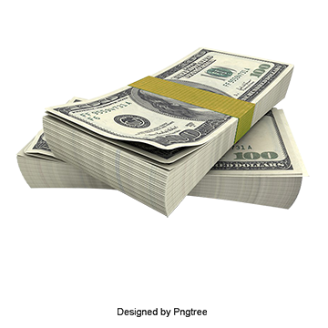
Game Show
https://create.kahoot.it/share/your-personal-bank-account/13240960-ae7d-43d8-87f5-0db61ab545d9

