Slide 1
National Board
Maintenance of Certification (MOC): Here We Grow Again!
Notes:
●Access and adapt your Facilitator Guide: https://docs.google.com/document/d/1OU4Ka9azzwp1AAwdrDLa7DHECYmfmhiYmlJMTNABsek/copy ●If you’d like to download the MOC Canvas course for Facilitators from Canvas Commons to adapt to your local context and needs, you can access the instructions here: https://docs.google.com/document/d/1fvCgx2WsMz2KR6T5YM7JuJk1md-m0Ovz_rs8V-xCVLI/edit?usp=sharing

Slide 2
Learning Outcomes
• Gain an understanding of the requirements of MOC
• Reconnect with the Five Core Propositions, Architecture of Accomplished Teaching & National Board Standards
• Explore ways to connect professional growth to student learning
• Review the legislation governing the SC National Board supplement and requirements for your state certificate
2
Notes:
Add note to this slide

Slide 3
Eligibility Details
NBCTs must submit MOC in their original certificate area,
in Year 4 or 5 of certification.
Considerations:
• Your teaching license must be current.
• If National Board certificate expires, teacher must complete entire process of initial certification to regain NBCT status.
• Meet all deadlines for registration, payment, and submission.
Be sure to update your “My Profile” in your National Board account.
3
Notes:
●Can start in the Fall two years before your certificate expires. ●First opportunity to apply for MOC: between September two years before your certificate expires and February one year before your certificate expires.●Second and last opportunity to apply for MOC: between September one year before your certificate expires and February of the year in which your certificate expires.

Slide 4
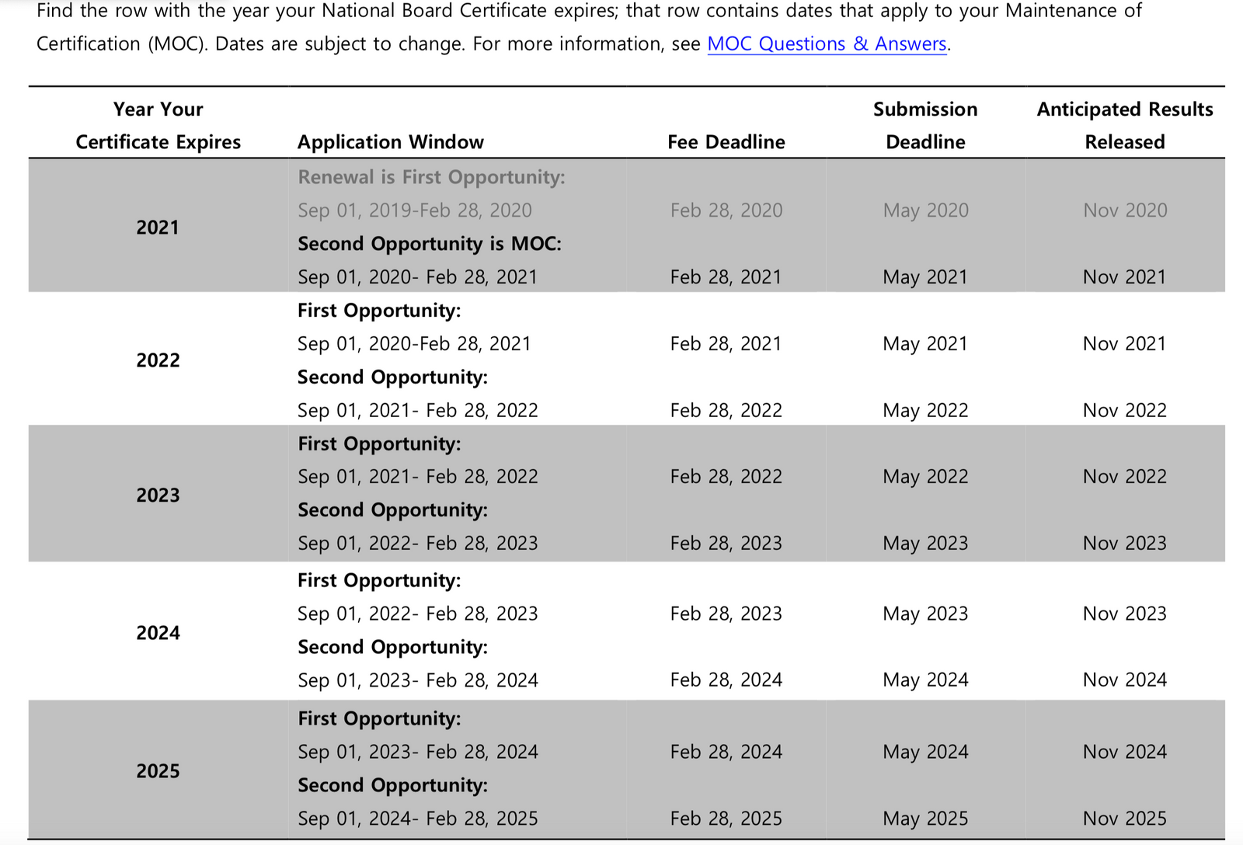
MOC Calendar
4
Notes:
Add note to this slide

Slide 5
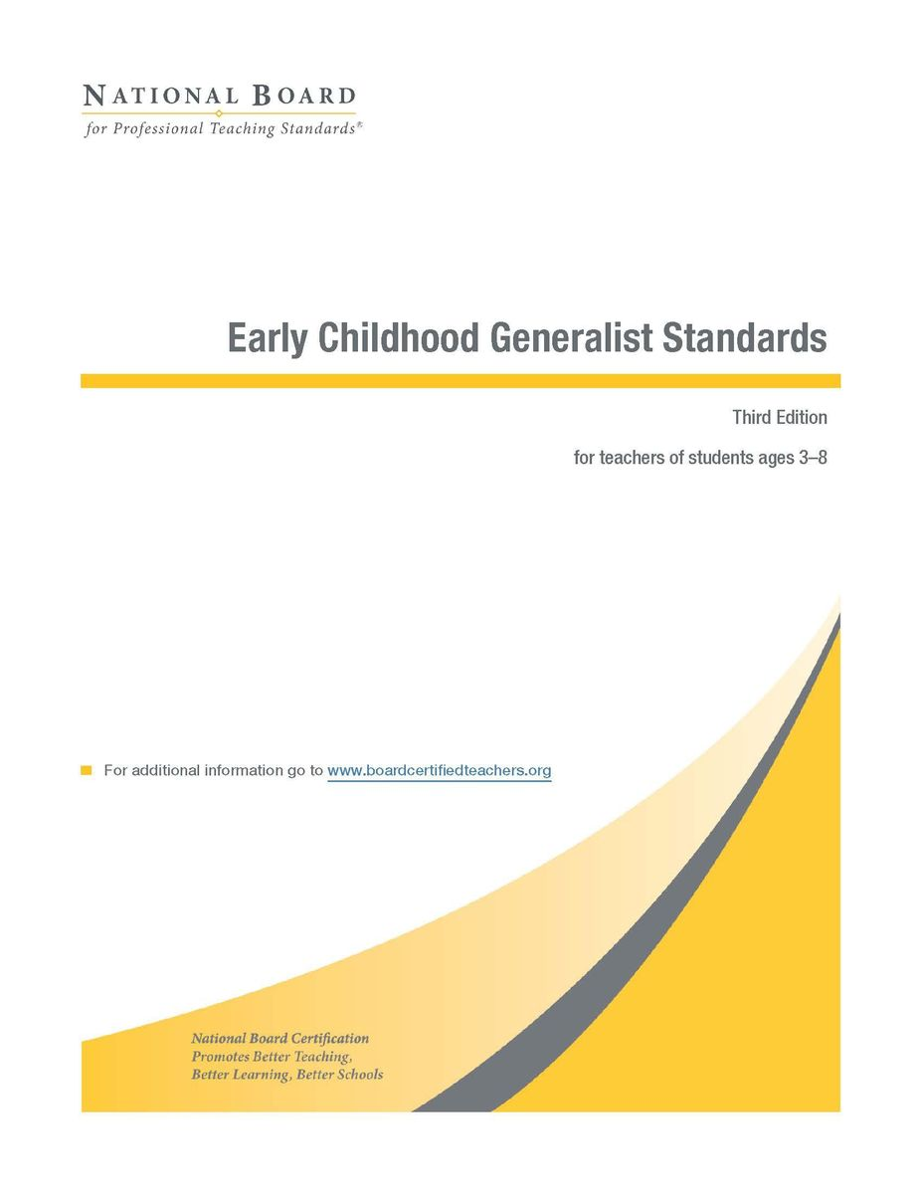
Resources
National Board Documents
• Guide to Maintenance of Certification (2020)
• Maintenance of Certification Instructions (2020)
• National Board Content Standards
• Student/Adult Release Forms
• Pursuing Certification During COVID-19
• Planning and Reflection Tool
• Video Analysis Checklist
5
Notes:
●MOC Guide, Instructions and Release: https://www.nbpts.org/national-board-certification-maintenance-of-certification/moc-overview/moc-guide/ ●Content Standards: https://www.nbpts.org/standards-five-core-propositions/

Slide 6
Vocabulary
• Maintenance of Certification (MOC): Means by which you keep your NB certificate active
• Professional Growth Experience (PGE): Ongoing, evolving, and varied activities in which you learn something new that has influence within or beyond the classroom and has a DIRECT or INDIRECT on student learning
• Samples of Products (SOP): Documents used as evidence to provide clarification and/or enhancement of the PGE
6
Notes:
Add note to this slide

Slide 7
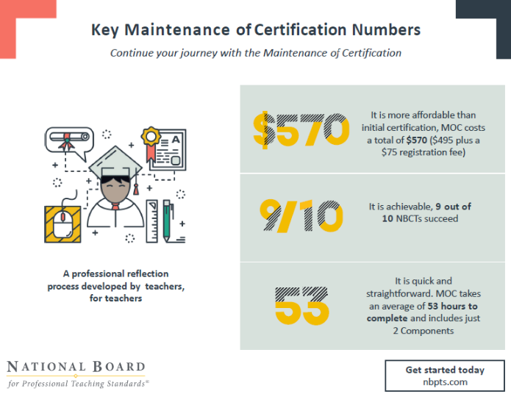
A professional reflection process developed by teachers, for teachers
7
Notes:
Add note to this slide

Slide 9
9
Notes:
Add note to this slide

Slide 10
Maintenance of Certification
NOT RE-Certifying
• You are keeping your certificate active – not recertifying.
• MOC measures how you have continued to grow professionally with a focus on impacting student learning.
• You must provide evidence that your teaching practice still exemplifies the NB Body of Knowledge (certificate area standards, Architecture of Accomplished Teaching, and Five Core Propositions).
Make sure to read the MOC Instructions, page 1
10
Notes:
●Facilitator should remind candidates to reference the instructions directly. (P. 1 of Instructions)

Slide 11
Accomplished Teaching
Body of Knowledge
• Five Core Propositions
• Architecture of Accomplished Teaching
• National Board Standards
Video: Body of Knowledge
11
Notes:
Add note to this slide

Slide 12
The Five Core Propositions
Teachers Are Committed to Students and Their Learning
Teachers Know the Subjects They Teach and How to Teach Those Subjects to Students
Teachers Are Responsible for Managing and Monitoring Student Learning
Teachers Think Systematically About Their Practice and Learn from Experience
Teachers Are Members of Learning Communities
12
Notes:
●You can create each banner separately so each Core Prop can slide in one at time.●Teachers are committed to students and their learning.●Teachers know the subjects they teach and how to teach those subjects to students.●Teachers are responsible for managing and monitoring student learning. ●Teachers think systematically about their practice and learn from experience.●Teachers are members of learning communities.

Slide 13
National Board for
Professional Teaching Standards
13
Notes:
●AAT is a metaphor for what accomplished teachers do in the classroom. What is visible in the classroom may be different but fundamental aspects of teaching are shared by all accomplished teachers. ●This slide goes through the steps of the Architecture of Accomplished Teaching.

Slide 14
Step | Description | Core Proposition | Collecting Evidence of Accomplished Teaching
1 | Know Students and Subject Area | Teachers are committed to students and their learning. | Who are my students? Where are they now? What do they need? In what order do they need it? Where should I begin?
2 | Set Learning Goals | Teachers are committed to students and their learning. | What high and worthwhile goals can be provided, at this time, in this setting, that are appropriate for these students?
3 | Implement Instructions to Achieve Goals | Teachers know the subjects they teach and how to teach those subjects to students. | What instructional strategies would be most effective for meeting goals? What materials, people, or places can I use to enhance student learning?
4 | Evaluate Student Learning | Teachers are responsible for managing and monitoring student learning. | Determine by evaluating student learning in relation to instruction—have goals been met?
5 | Reflect on Teaching Practice | Teachers think systematically about their practice and learn from experience. | What would I do differently? What are my next steps?
6 | Set New Learning Goals | Teachers are responsible for managing and monitoring student learning. | Based on evaluations of student learning of these students at this time, what goals would now be appropriate to set for students?
Notes:
●Note: This chart helps NBCTs draw connections between the AAT and 5 Core Propositions

Slide 15
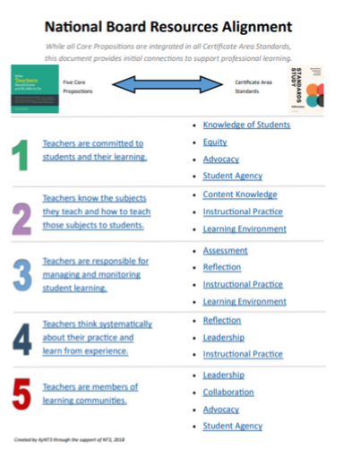
Cross-Certificate Standard Study
The Standard Studies are a reorganization of the Certificate Area Standards created for the National Board Certification process. The Studies group Standards or sections of Standards across common themes to facilitate professional learning for all teachers across the educator career continuum.
Standard Studies
15
Notes:
●It is important to recognize that the committees that developed the Standards did not intend that the Standards be pulled apart and reorganized in this way; the Standards were created holistically as a measure of what it means to be accomplished in each certificate area.●Therefore, if candidates engage in the use of the Standards Studies, they should be cautioned to not rely on these documents to understand their full Standard; candidates should read the full certificate area Standard. ●As each set of Standards is created by a committee of teachers, each committee may determine to organize the Standards in a different way, making it difficult for cross-certificate area conversations. Likewise, the length of each Standard can be daunting initially. ●These Studies are intended to make it easy to facilitate professional learning across certificate areas and as an introduction to the Standards. If teachers want to learn more, the entire certificate area Standard is hyperlinked at the end of every section of the Studies.

Slide 16
Evaluation
•Holistic scoring completed by NBCTs using criteria in the rubric found on page 14 of the MOC Instructions
•You will receive a decision rather than a score, which means there is no score banking
•Results reported as
•Maintained
•Not Maintained (with feedback)
16
Notes:
Add note to this slide

Slide 17
MOC Important Dates and Deadlines
MOC Guide, page 2
17
Notes:
●Facilitator should remind candidates to reference the instructions directly. (P. 2 of Guide)

Slide 18
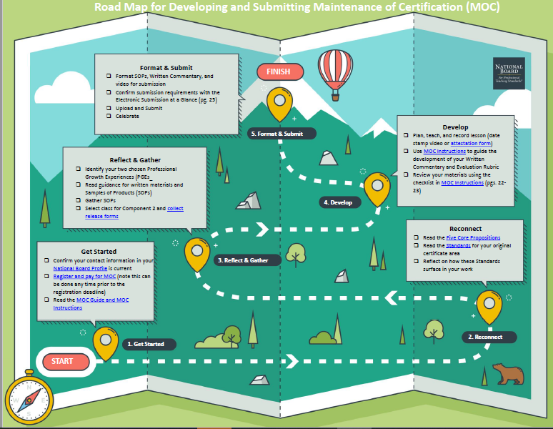
18
Notes:
●The slides that follow are intended to support candidates planning and developing their MOC

Slide 19
Ensuring Equity in Instruction
Fairness
• Dedication to awareness of bias and making sure that bias does not lead to injustice, harm, negative impact
• Fairness is done for all students. All students should have learning environments where biases do not negatively affect them.
Providing Access
• Access is the ability, right, or permission to approach, enter, speak with, or use; admittance
• Preference of learning (whole/small groups, individual work, visual, auditory, kinesthetic)
• Peer interactions
• Resources
• Room arrangement
• Lessons taught to all
19
Notes:
Add note to this slide

Slide 20
Professional Growth Experiences
• New learning (ongoing, evolving, and varied)
• Influence within or beyond the classroom
• Direct or indirect impact on student learning
• Both PGEs must show professional growth of the original certification area
Read pages 4-8 in the MOC Instructions for more details on PGEs. Select PGEs that allow you to showcase not just your accomplishments, but what you did—what steps you took, what milestones you achieved—to reach that level of accomplishment.
20
Notes:
●Facilitator should remind candidates to reference the instructions directly. (P. 4-8 of Instructions)

Slide 21
Examples of Professional Activities
• obtain a grant for and implement a special project in your school
• organize family or community activities related to supporting students or providing equitable access to education
• provide mentoring, coaching, or other training to new teachers on an ongoing basis
• play a significant role in special projects at the school, district, or higher level that had a positive impact on students
• perform a needs analysis for instructional resources and develop a plan based on the results
• conduct research that led to changes in your or others’ instructional practice
• collaborate with colleagues, community members, and/or families to meet the needs of students
• create a website that is actively used by students and families to facilitate regular communication between school and home
MOC Instructions, page 4
21
Notes:
●Facilitator should remind candidates to reference the instructions directly. (P.4 for PGEs and 7 of Instructions)●Emphasize that it’s all about connecting the PGE to student learning

Slide 22
PGE Brainstorming and Organizing
• Using sticky notes, jot down every professional experience you’ve had in the past 5 years.
• Sticky notes can be paper or electronic (linoit, padlet, etc).
• One experience per sticky.
• Sort/Group the different experiences into similar categories.
• These categories should address specific needs (Refer to Prompts 1 and 2 in Written Commentary).
• Each category should fit a professional, student, and/or community need.
• Label the categories.
• Decide which categories would work best as your PGEs.
• At least one category should be able to lead to a video-recorded lesson in your original certificate area and development level.
22
Notes:
●Note: Slide titled: PGE Brainstorming and Organizing Activity and Slide titled:Nearpod OR Lino or JamBoard are duplicate activities. Facilitator can determine which activity to conduct depending if this workshop is held virtually or face-to-face.

Slide 23
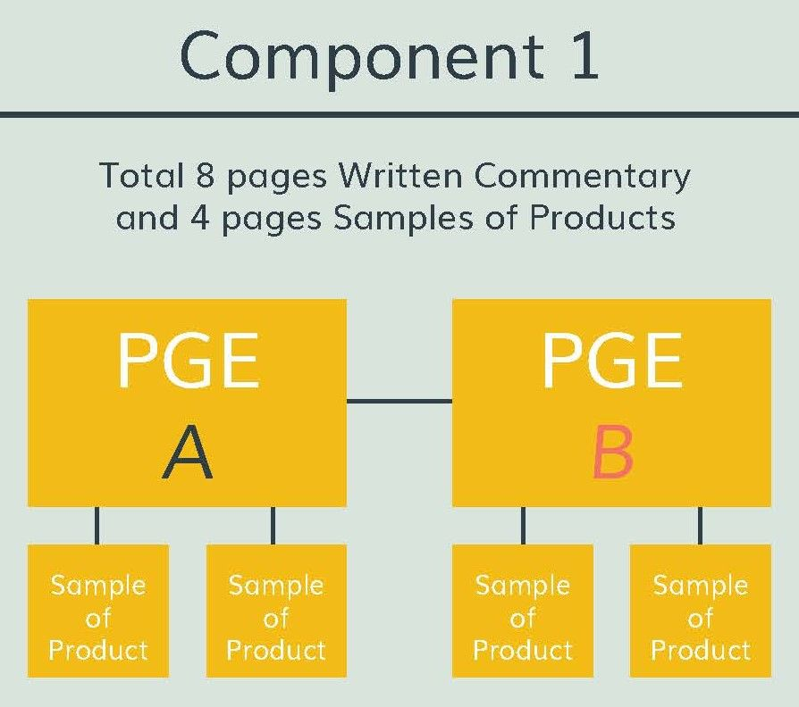
Component One
Deep Dive
23
Notes:
Add note to this slide

Slide 24
Component One
• 4 pages of Written Commentary per PGE (8 pages total)
• Written Commentary must be submitted in provided template
• 2 pages of Samples of Products (SOP) per PGE
• 12 pages total
MOC Instructions, pages 16-20, 26-27
24
Notes:
Add note to this slide

Slide 25
PGE Written Commentary
For each PGE Written Commentary, a candidate is required to answer these five prompts.
1. Provide a context of the professional situation that indicates what need(s) of students, the professional community, parents/guardians, and/or yourself you are addressing with each PGE.
2. Describe each PGE and how each of your PGEs demonstrates a response to the identified need(s).
3. In the context of each of your PGEs, explain how you have acquired and deepened your certificate area-specific content knowledge and/or your pedagogical knowledge and skills to remain current, including use of research and/or use of other professional activities.
4. Analyze ways in which each of your PGEs and related activities positively impacted student learning whether directly or indirectly.
5. Reflect on each of the PGEs presented, and on changes, additions, and/or next steps that would enhance your professional growth in the future.
MOC Instructions, page 17
25
Notes:
●Facilitator should remind candidates to reference the instructions directly. (P. 17 of Instructions)●Candidates often question the term context. Provide a working explanation of this term. ●Context provides a big picture/background or the why of the identified need. The need provides a more detailed explanation of what needs to be addressed and the why. ●Example of CONTEXT: The global pandemic has required teachers to explore virtual/remote teaching and learning opportunities. ●Example of NEED: Students need to have more opportunities to engage with content during virtual settings to scaffold and comprehend content. ●Example of RESPONSE to the NEED/PGE: Teacher engages in or leads professional development exploring best practices to engage students in virtual learning.

Slide 26
Respond to the following prompts for one or both of your PGEs
1. Describe how you have effectively integrated technology in your practice.
2. Explain how you have ensured fairness and equity of access, and promoted appreciation of diversity among the students and the learning community.
3. Explain how your interaction with colleagues, other professional groups, parents, and/or community members has enhanced your professional growth.
4. In the broader context of your PGEs and your practice, analyze patterns or themes that have emerged that define you as an educator, as you reflect on your professional growth since certification.
MOC Instructions, page 17
26
Notes:
●Facilitator should remind candidates to reference the instructions directly. (P. 17 of Instructions)

Slide 27
Examples of Samples of Products (SOPs)
Appropriate types of evidence may include, but are not limited to the following:
• student work products (e.g., examples of students’ writing, artwork, self-reflections on their learning, three-dimensional work products)
• photographs of non-text student work (e.g., artwork, engineering design product) or of students engaged in learning activities
• student test scores or other measures of students’ performance
• testimonials from teachers or other staff regarding outcomes related to implementation of training/mentoring you have provided
• emails from students’ families
• quantitative or qualitative data related to student engagement or attitudes toward learning
• attendance and/or graduation rates
• outcomes for particular student populations
• data related to use of resources (e.g., library, technology) in support of student learning
• an excerpt of a website, a blog, or an article or paper that you wrote or created
• a summary of the outcomes of a project you worked on or implemented
MOC Instructions, page 8
27
Notes:
Add note to this slide

Slide 28
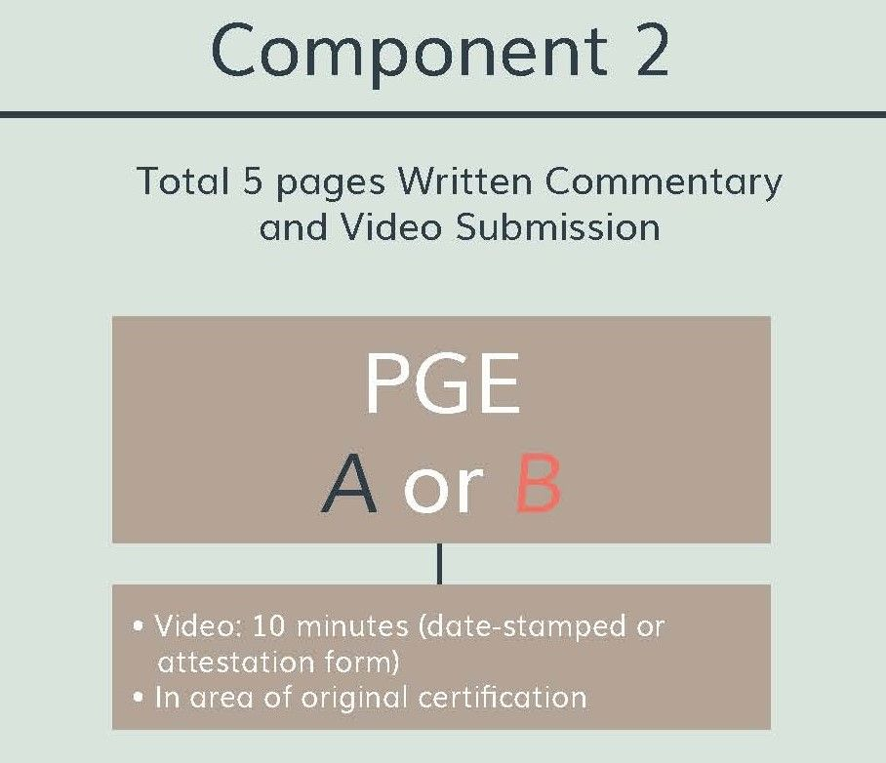
Component Two
Deep Dive
28
Notes:
Add note to this slide

Slide 29
Component Two
Written Commentary
No More than 5 Pages
Video
10 Minute Max
29
Notes:
●Facilitator should remind candidates to reference the instructions directly. (P. 20 of Instructions)

Slide 30
Component Two Video
• Showcases a lesson in your original certification area
• Can be recorded no earlier than September 1 in the year prior to your first year of MOC eligibility (two years before your certificate expires)
• Can be segmented into 3 parts (10 minutes max)
• Must be date stamped (or have attestation form)
• Must show you and your students together in at least one segment, your students interacting with one another, your students’ reactions to what you are doing, and their engagement in learning
MOC Instructions, pages 20-25, 27
30
Notes:
●Facilitator should remind candidates to reference the instructions directly. (P. 20-25 and 27 of Instructions)

Slide 31
Component Two Prompts
1. How has your learning or professional growth, as described in the PGE, been applied in this lesson?
2. For the featured lesson, what were your goals, and how did they fit into the broader context of learning for these students?
3. Why is this instruction important for these students at this particular point in time?
4. How did you ensure fairness and equity of access, and promote appreciation of diversity among the students?
5. How does the video recording reflect your certificate-specific content knowledge?
6. Explain the impact of your teaching on student learning. Cite specific examples from the video recording and identify what they illustrate.
7. Reflecting on the activity presented in the video, discuss any changes and/or additions that would have enhanced student learning.
8. Reflecting on the activity presented in the video, discuss any changes, additions, and/or next steps that would enhance your professional growth in the future.
MOC Instructions, page 24
31
Notes:
●Facilitator should remind candidates to reference the instructions directly. (P. 24 of Instructions)

Slide 32
Formatting
• 8.5" × 11" page with 1" margins = 1 page
• 11-point Arial font
• Bold and/or italics can be used for emphasis
• Double space
• Spell out the first occurrence of acronyms
• Microsoft Word, Open Office, or PDF file
• No last names (anonymity)
Component 2
Written Commentary (up to 5 pages)
+
Video (up to 10 minutes)
MOC Instructions, pages 19, 25, 28-29
32
Notes:
●Facilitator should remind candidates to reference the instructions directly. (pages 19, 25, 28-29)

Slide 33
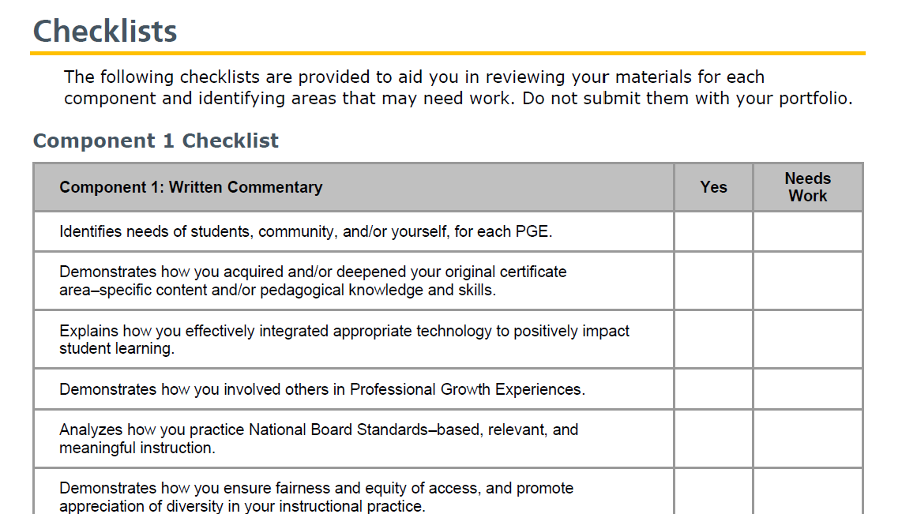
Checklists
MOC Instructions, pages 26-27
33
Notes:
Add note to this slide

Slide 34
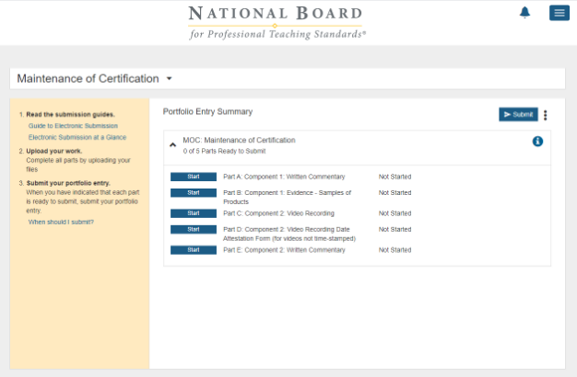
Online Submission Platform
34
Notes:
Add note to this slide

Slide 35
South Carolina NB Supplements
• Applied for initial certification before July 2010— receive $7500 supplement annually for duration of certificate; eligible for supplement upon successful completion of MOC as long as you have not previously renewed your National Board certificate
• Applied for initial certification after July 2010— currently scheduled to get $5000 supplement for duration of initial certificate; not eligible to extend the period of supplement eligibility at this time
• Supplement based on position educator holds
• SC National Board supplement information is subject to change.
35
Notes:
Add note to this slide

Slide 36
Next Steps
• Update your National Board account
• Register/pay fees by deadline: $495 + $75 registration fee
• Select ‘yes’ to release name to third-party Agreement during registration (if applicable)
• Download materials
• READ YOUR STANDARDS
• Decide upon your PGEs (often the hardest part!)
• Get Student/Adult Release Forms signed
• Coordinate video recording equipment and support
36
Notes:
Add note to this slide

Slide 37
Jenna Hallman, PhD, NBCT
hallmanj@cerra.org
Suzanne Koty, PhD, NBCT
suzanne@cerra.org
37
Notes:
Add note to this slide

