Slide 1
the ADMINISTRATOR’s Role in Induction and mentoring
Notes:
Begin the day by welcoming the participants to the training. Give each trainer a moment to quickly introduce himself/herself by giving his/her name and current role. Explain that today’s training will last about two hours and will include opportunities for discussion. We will focus on providing an overview of the mentor’s work and an argument for induction and mentoring. We also will examine the specific responsibilities you will assume within your district’s induction and mentoring program.
Ask the participants to take a few minutes to read “The Developmental Stages of Teachers” by Lilian G. Katz.

Slide 2
DebrieF
Considering the article, “The Developmental Stages of Teachers” by Lilian G. Katz:
What are your major take-aways from the article?
How do the developmental stages of teachers impact your work as an administrator?
Notes:
Explain that the participants will now have an opportunity to get to know one another, while also discussing “The Developmental Stages of Teachers” article. Ask the participants to find someone they do not know, introduce themselves, and share their thoughts about the article. Allow 5 minutes for these introductions and discussions. Before the participants return to their seats, ask each person to introduce himself/herself by giving his/her name, district, and role. The trainer should model this process, being careful to keep the introduction brief. Once everyone has been introduced, the participants can return to their seats. Once everyone is seated, the trainer should ask the participants to share any major take-aways from the article. The discussion should focus on how the developmental stages will relate to their work as an administrator.

Slide 3
What I know about Induction and Mentoring | What I need to know about Induction and Mentoring | What I need to do to support mentors and beginning teachers
3
Notes:
Pass out the “What I Know, Need to Know, and Need to Do” handout. Explain that this document should be used as a note-taking guide throughout the training. Encourage the administrators to capture data, ideas, and questions on the form. We will engage in conversation about the “What I Know,” “Need to Know,” and “Need to Do” categories at the end of the training.

Slide 4
Beginning teacher needs
Social/Emotional | Physical | Instructional
Notes:
Mentors are trained to treat each beginning teacher as an individual. This means mentors must assess the beginning teacher’s needs and provide specific support. Regardless of the need being addressed, it will typically fall into one of these three categories: social/ emotional, physical, or instructional. Social/emotional needs of beginning teachers ideally have to be met before any quality instruction can take place. Teachers need to feel valued as an integral part of something meaningful. They need to be heard and made to feel that their struggles are legitimate and that they are important members of an institutional system that fosters support and development. Establishing personal connections is also necessary in meeting social/emotional needs. Many beginning teachers are new to the area, some may have no family or friends nearby, and others may be away from their home for the very first time. These are all possible scenarios that a mentor must be prepared to handle.
Mentors must be able to help the beginning teacher find his/her place in the school and in the community. Physical needs of beginning teachers are centered on structure, culture, policies, and procedures. Trainers should discuss that the term physical, in this sense, does not refer to the “body.” It refers to the “building” – the procedural, structural, and operational aspects of the building. Teachers must understand how the school operates outside of instruction – the “who’s” and “how’s” of the school. Whom do I call if I need a restroom break during class? How do I secure a substitute teacher when I have an upcoming doctor’s appointment? Beginning teachers also need to be made aware of school culture. For example, this could mean the level of parental involvement occurring throughout the school. A mentor should also be prepared to communicate district policies and procedures with beginning teachers, particularly those that may not be fully enforced in the school or those that are not necessarily
written in a handbook, but are just “understood.”
Social/emotional and physical needs can be viewed as basic needs, like in Maslow’s hierarchy of needs. These basic, lower-level needs must be reasonably satisfied before meeting more advanced, higher-level needs – creativity, problem-solving, lack of prejudice, etc. – that are often instructional in nature. The instructional needs category is immense. It includes any needs a teacher has that impact his/her ability to plan lessons effectively, deliver quality instruction to every student in the classroom, and assess learning. Instructional needs also include topics such as building relationships with parents and students, scheduling, and grading. An instructional need could be related to help with locating materials for a particular lesson, or it could involve assistance with teaching a group of special education students who are in the class. Due to recent changes in the SC ADEPT Support and Evaluation System, beginning teachers may need their mentors to help with writing Student Learning Objectives (SLOs) or with understanding the South Carolina Teaching Standards (SCTS) 4.0 Rubric. Again referring to Maslow, once these instructional needs are satisfied and beginning teachers begin to gain self-esteem and confidence in the classroom, they will begin to develop a sense of efficacy.
Tell participants to remember this slide and these categories because we will be working with them again.

Slide 5
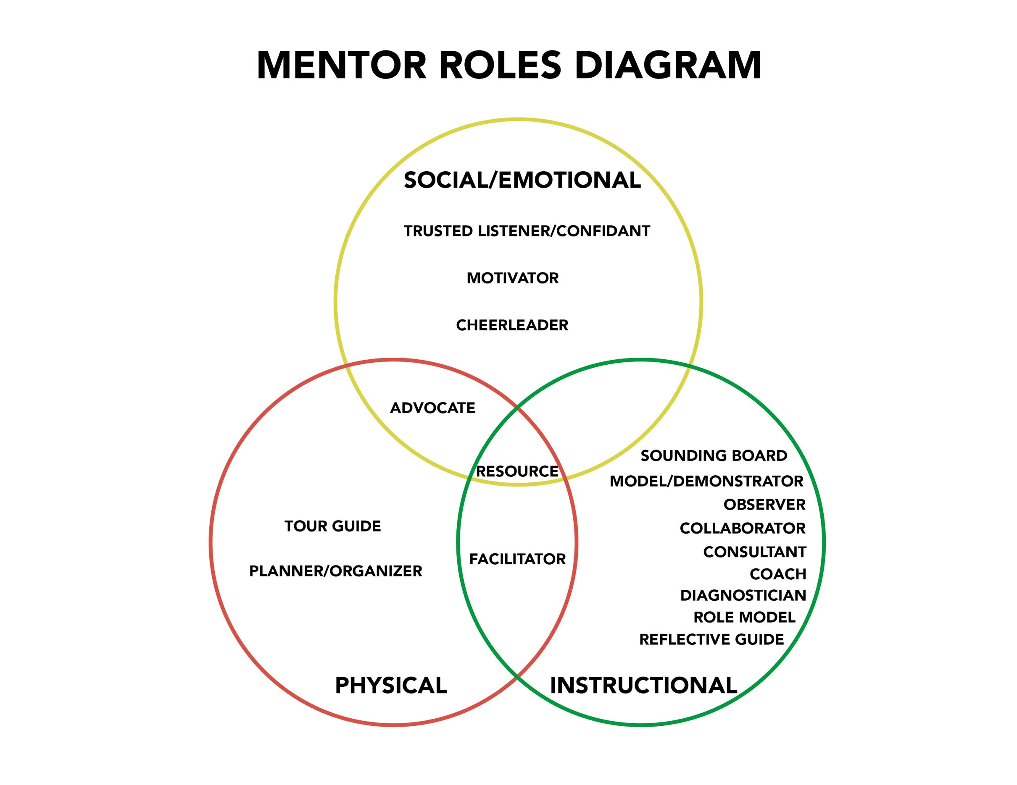
DIFFERENTIATED MENTORING
Notes:
Mentors are taught that the roles and responsibilities they assume within the mentoring relationship should always be aligned with the needs of the beginning teacher. In simpler terms, the beginning teacher’s need will determine the role assumed by the mentor. Just as needs can be grouped into three categories (social/emotional, physical, and instructional), so can roles. If the mentee’s need is instructional, then the mentor’s role becomes instructional. And so on. Roles, however, can often fall into multiple
categories as their titles can be fairly generic (i.e., advocate, facilitator, resource, etc.). For example, a mentor can serve as an advocate for a new teacher in many different settings and for many different reasons.
Additionally, mentors functioning within one category may assume multiple roles within that same category based on the mentee’s need. For example, an “instructional” role can take on many forms. If the mentee needs help gathering and analyzing student data, the mentor would approach this particular situation as a data coach. If the mentee asked for help teaching a lesson on fractions, the mentor could assume the role of a model/demonstrator if he/she is well-versed in this content area. If the mentor, however, is not a math teacher, he/she becomes more of a professional resource and directs the mentee to a colleague who does teach this subject. Mentors must be able to step in and out of these roles and differentiate their support in order to become effective in moving the beginning teacher's professional practice forward.
Regardless of the role assumed, the mentor must remember to differentiate his/her support to meet the beginning teacher’s needs. This means that the mentor’s role(s) will be determined by the beginning teacher’s need(s).

Slide 6
THE Importance of Mentoring
6
Notes:
While we understand that teachers and administrators are extremely busy, we also believe in the value of a strong mentoring and induction program. The next few slides will give us an opportunity to shares the reasons we believe mentoring and induction programs are so important.

Slide 7
4,100 - 4,900
Over the last three years, between 4,100 and 4,900 teachers left their teaching
positions each year and did not return to teach in any SC public school district.
$21.5 - $46.7 million
Replacing public school teachers costs SC between
$21.5 and $46.7 million each year.
Notes:
Ask the participants what they believe these numbers represent. Allow several participants time to give their thoughts. Explain that the range indicates the number of teachers who have left their public school teaching positions and did not return to TEACH in any SC public school district each year over the last three years. Further explain that a 2014 study (that uses data from 2008-09) includes estimates for the cost of attrition per teacher by state. Using the cost estimates provided in the study and the number of teachers leaving their positions, it is estimated that replacing public school teachers annually costs South Carolina as much as $46.7 million. The study also estimated that teacher turnover costs the nation approximately $2.2 billion each year. Due to inflation and some recruitment costs that are not included in these figures, the total cost of attrition in the state and in the nation are likely much higher. Note to Trainer: Be sure to reiterate the fact that the range on the slide is likely an underestimate for the total cost of attrition.

Slide 8
teacher turnover in south Carolina
SC Teacher Retention Issue
4,100 - 4,900 teachers left
1,500 - 1,800 had < 5 years of experience
580 - 620 had < 1 year of experience
22% of the beginning teachers hired in 16-17 did not return the following year
There is some good news! For the 2017-18 academic year, districts reported fewer early career teacher departures!
Notes:
Reminder, none of these numbers include teachers who took a teaching position in another SC district.
Like many states in the country, South Carolina faces an acute issue with teacher retention. Over the last three school years, between 4,100 and 4,900 teachers left their teaching positions each year and did not return the following school year to TEACH in any South Carolina public school district. What is of even greater concern is the number of these departing teachers who are in the early stages of their careers. Of the 4,100 – 4,900 teachers who left their positions each year, between 1,500 and 1,800 had five or fewer years of experience in the classroom. Furthermore, between 580 and 620 teachers had only one year or less of teaching experience. These statistics are troubling for many reasons, including the fact that 22% of the beginning teachers who were hired for the 2016-17 school year did not return to teach in any South Carolina public school district the following year. That is more than 1 in 5 new teachers who left during or at the end of their first year in the classroom. Unfortunately, this occurrence is not unique to one school year. It is a multi-year trend, and the number of teachers who leave continues to grow. Be sure to end by sharing some good news - for the 2017-18 school year, districts did report slightly fewer early-career teachers (those with 0-5 years of experience) who left their positions during or at the end of the previous school year.

Slide 9
teacher turnover in south Carolina
Understandable Reasons
Involuntary Dismissal
Frustration
Relocating
Staying home with young children
Why did these
early career
teachers
leave?
Sense of isolation
Lack of support
Notes:
Many of these early-career teachers left their positions for understandable reasons, such as relocating with a spouse or staying home with young children. Other departures were due to an involuntary dismissal. But, far too many teachers left for reasons related to frustration, insufficient preparation, a perceived lack of support, classroom management difficulties, and numerous other reasons. These teachers often feel so isolated and unsupported that they end up leaving the classroom or the profession altogether. This attrition not only impacts the learning that should be taking place in the classroom, but it is also very costly for schools and districts to recruit, hire, and induct new teachers every year.

Slide 10
south Carolina DATA
Notes:
Before passing out the “Teacher Turnover in South Carolina” document and the South Carolina district maps, explain that this activity includes an opportunity for the participants to examine actual district-by-district teacher turnover rates. The information allows participants to have an informed conversation about teacher retention in individual districts.

Slide 11
south Carolina Data
Abbeville
Teacher Turnover Rates*
2016-17 | 2015-16 | 2014-15 | 2013-14 | 2012-13
6.5% | 5.9% | 7.8% | 8.2% | 10.8%
*Data from SCDE Report Cards; Includes everyone who
left a teaching position for any reason.
Notes:
In preparation for this activity, trainers must review the current year’s teacher turnover data. While it is not necessary to memorize turnover rates or the number of teachers who did not return to a specific district in the designated school year, it is important that trainers understand what the reported data actually mean. The information below should assist trainers with this task:
• Teacher turnover rates come from the South Carolina Department of Education. The previous year’s rates are reported during the current school year.
• The teacher turnover rates include everyone who left a teaching position in the district for any reason (retirees and individuals who voluntarily or involuntarily left the district). It is fair to assume that some of the teachers included in the turnover rates have left the profession, while others have simply taken different teaching positions in the state/country. Some are still employed in the same South Carolina district, but moved into a non-teaching position (i.e., assistant principal, district coordinator, etc.). It is important to recognize that the participants (administrators) in the room may be represented in the turnover rates depending on how recently they moved into their position.
While the trainer will highlight individual districts for the purpose of guiding the discussion, this is not intended to be a finger-pointing exercise. Abbeville was selected for this slide simply because the district comes first in alphabetical order. Trainers should use this slide to describe how to interpret the data participants are about to receive.
Note to Trainer: The state teacher turnover for 2016-17 is 7.7%, and it has been increasing each year represented on the slide.
Pass out the “Teacher Turnover in South Carolina” document (1 per participant) and the South Carolina district maps (1 per table). The maps give the participants a visual to help them understand the relative size of the districts and the district’s location in the state. Ask the participants to take 3-4 minutes to review the data on their own.

Slide 12
south Carolina Data
What trends (district and state) do you notice when you examine the teacher turnover rates?
What factors might have impacted these numbers?
What do these data tell us?
What impact do administrators have on a district's turnover rates?
Notes:
After 3-4 minutes of individual work, invite the participants to hold a 10-minute table discussion about the questions on the slide. The trainers should circulate throughout the room answering questions and guiding the discussion.

Slide 13
south Carolina Data
Attrition can be prevented with meaningful mentoring and induction programs.
Today more than half of all states require that new teachers participate in some form of induction or mentoring program.*
South Carolina mandates both!
Every program must include trained mentors who are
assigned to work with induction teachers.
*Wei, R.C., Darling-Hammond, L. & Adamson, F. (2010). Professional development in the United States: Trends and challenges. Retrieved from https://edpolicy.stanford.edu/sites/default/files/publications/professional-development-united-states-trends-and-challenges.pdf
Notes:
Many of these occurrences of attrition among early-career teachers could be prevented with meaningful mentoring and induction programs. These support programs are designed to improve the performance and retention of beginning teachers, ultimately resulting in student achievement and growth. Today more than half of all states require that new teachers participate in some form of induction or mentoring program. South Carolina mandates both – a formal induction process that includes a mentoring component. Each district in this state is required to provide teachers under induction contracts with comprehensive guidance and assistance throughout the school year. While the structure of these programs can vary across districts, every program must include a district induction and mentoring coordinator and trained mentors who are assigned to work with induction teachers. Mentors receive explicit instruction during a two-day training on how to support a beginning teacher effectively. Because effective induction programs also include a school level program organized and facilitated by the administrator, it is important for principals and assistant principals to understand the importance of this work.
Recognize the fact that a great deal of research exists on the topic of mentoring and that as a result of this research, mentoring has been shown to have a positive impact on novice teachers. Ask the participants to predict or recall from previous learning the specific ways mentoring impacts beginning teachers. Participants should call out their ideas.

Slide 14
Impact of mentoring*
Beginning teachers who participated in some kind of induction with a mentoring component had higher satisfaction, commitment, or retention.
Beginning teachers who participated in some kind of induction with a mentoring component performed better at certain aspects of teaching.
Students of beginning teachers who participated in some kind of induction with a mentoring component had higher scores or gains on academic achievement tests. *Ingersoll, R., & Strong, M. (2011). The impact of induction and mentoring programs for beginning teachers: A critical review of the research. Review of Education Research, 81(2), 201-233.
Notes:
Research and experience tell us that novice teachers benefit from mentor support early in their careers. This type of support is critical to beginning teachers as they are learning their trade. Mentoring has been proven to positively impact teacher satisfaction, retention, and performance.
A recent examination of 15 empirical studies conducted since the mid-1980s about the effects of induction and mentoring on beginning teachers revealed the following results:
• Beginning teachers who participated in some kind of induction with a mentoring component had higher satisfaction, commitment, or retention.
• Beginning teachers who participated in some kind of induction with a mentoring component performed better at certain aspects of teaching (i.e., keeping students on task, developing workable lesson plans, using effective questioning practices with students, providing differentiated instruction to meet students’ needs and interests, demonstrating successful classroom management, etc.).
• Students of beginning teachers who participated in some kind of induction with a mentoring component had higher scores or gains on academic achievement tests.
There is no shortage of evidence to prove that mentoring, if carried out appropriately, can lead to many positive gains in our state. We also know that depending on the size of a district and the comprehensiveness of its induction program, effectively supporting new teachers can be expensive. Many of the public school districts in this state experience budget shortfalls every year and are forced to make cuts in certain areas. With thousands of early-career teachers leaving their positions annually and a declining number of students completing in-state teacher education programs each year, our public school districts need to do whatever they can to retain teachers who have the potential to be successful. Since this training is not designed to figure out how to recruit more good teachers, we need to focus on keeping them in the profession by pairing them with quality mentors. This is the reason the South Carolina Mentor Training is so important and why mentors need the support of the school administrator.

Slide 15
Tough Math!
Over the last three years, an average of:
6,934 public school teachers were hired in South Carolina
4,610 public school teachers left their positions and did not return to teach in any South Carolina district
1,732 students graduated with a Bachelor’s degree eligible for teacher certification in South Carolina
This number has been
declining since 2012-13.
Notes:
End this section by explaining that teacher retention is a necessary goal for the South Carolina mentoring program. It is possible to sum up our state’s retention challenge with data from the last three years. Discuss the numbers on the slide.
When we fail to retain teachers who have the capability to be successful in the classroom, we quickly move the state towards a teacher shortage. It is important for the participants to understand that we cannot recruit ourselves out of the current teacher shortage, which is why we must focus our time, energy, and even money on the retention of teachers who have the capability to be effective in the classroom. Explain that while teacher retention is important, mentoring is also focused on improving teacher practice so that students are able to make more academic gains.

Slide 16
WHAT MENTORS LEARN IN TRAINING
16
Notes:
While we understand that teachers and administrators are extremely busy, we also believe in the value of a strong mentoring and induction program. The next few slides will give us an opportunity to share the reasons we believe mentoring and induction programs are so important.

Slide 17
The South Carolina Mentor Training:
A succinct, systematic approach to mentoring
Notes:
The two-day South Carolina Mentor Training is divided into seven modules that each consist of two or more sections. Day 1 of the training focuses on fundamental concepts for effective mentoring and the Expanded ADEPT Support and Evaluation System. Day 2 of the training includes instruction on and practice with the mentoring cycle.

Slide 18
mentors serve:
Beginning teachers
Student interns
Experienced teachers who are new to a particular district or the state
Teachers on diagnostic assistance
Notes:
The SC Mentor Training provides mentors with the skills necessary to support a teacher’s professional growth regardless of the teacher’s level of experience. Mentors may be asked to mentor a student intern, a beginning teacher, a teacher who is new to the district but not the profession, and/or a teacher on diagnostic assistance. A differentiated mentoring approach within the structure of the mentoring cycle will allow the mentor to meet the teacher’s needs regardless of his/her classification.

Slide 19
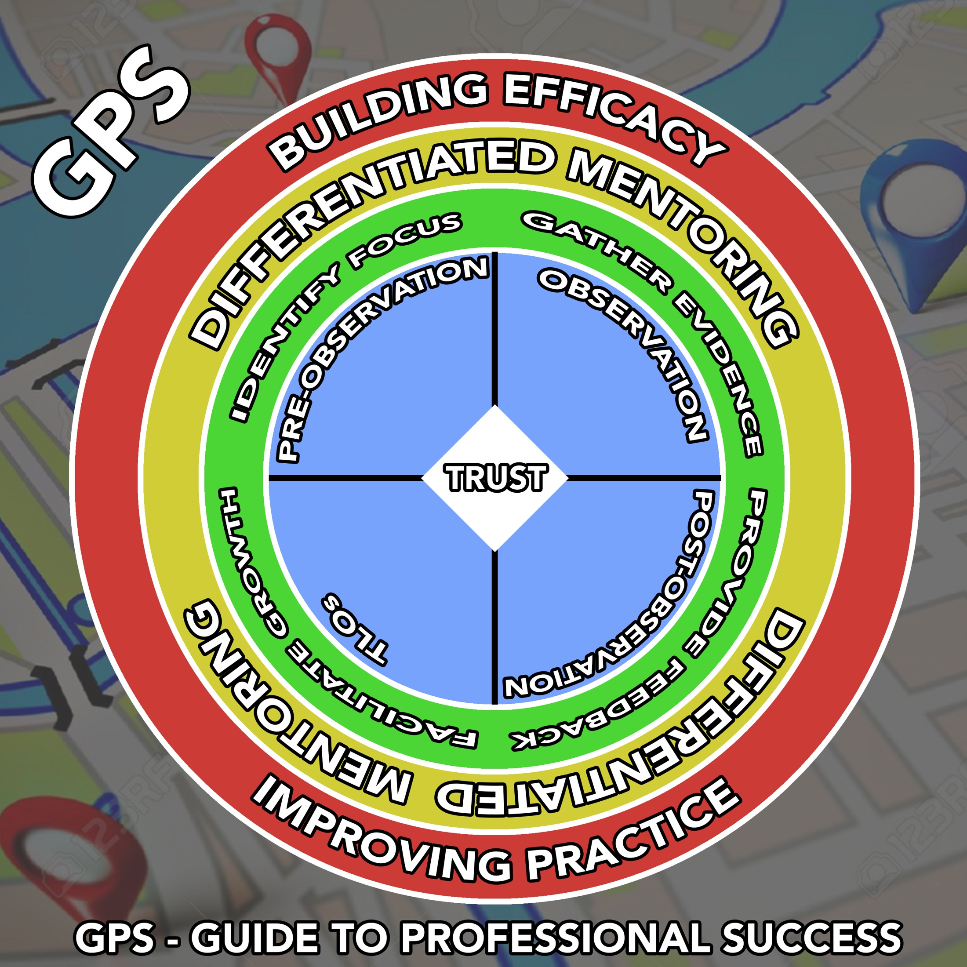
Notes:
The Guide to Professional Success (GPS), shown on the screen, is a graphic that displays the four steps of the mentoring cycle. The four quadrants depicted in blue represent the steps in the mentoring cycle. In the ring directly outside of each quadrant, the primary purpose of each step in the mentoring cycle is displayed. “Differentiated Mentoring” is consistently displayed in the second ring outside of each quadrant because, regardless of which step the mentor is currently engaged in, he/she must provide differentiated mentoring to the beginning teacher. The outermost ring represents the ultimate outcome of a successful mentoring relationship which involves the mentor providing differentiated support in a way that enables the beginning teacher to build efficacy and improve his/her practice. Finally, the diamond at the very center of this graphic signifies trust. A trusting relationship between the mentor and the mentee must exist before any other feature in this graphic can be put into practice.
Participants may hear the first three steps in the mentoring cycle referred to as the “POP Cycle.” This mentoring cycle was developed through extensive research, invaluable feedback from educators across the state, and an ongoing partnership between CERRA and the South Carolina Department of Education (SCDE). The cycle has been vetted by multiple groups of diverse educators in South Carolina and is designed to meet the specific needs of South Carolina’s public schools. All of these collaborative efforts that have taken place over recent years validate the importance of the four-step mentoring cycle that is being introduced. Let’s talk about each step in the cycle in a little more detail.
The first step of the mentoring cycle is the pre-observation conference wherein the mentor uses specific coaching dialogue (similar to the dialogue and protocol taught during SCTS 4.0 Rubric evaluator training) to encourage the beginning teacher to share about his/her upcoming lesson. The primary purpose of this stage is to provide an opportunity for the mentor and mentee to jointly identify and agree upon a particular focus for the upcoming classroom observation. The mentor will conduct this observation to gather evidence about the beginning teacher’s instructional skills. The focus may be identified by the mentee directly saying, “I need help with classroom management,” or it could come from the mentor asking the mentee questions about classroom challenges and determining the focus based on this dialogue. Other topics to be discussed in the pre-observation conference may include lesson plans and long-range plans developed by the beginning teacher, various assessments that the beginning teacher will use to measure student growth, expectations about the upcoming observation (day and time), and the overall mentor-mentee relationship (the mentor’s role is not evaluative). The pre-observation conference may also provide an opportunity for the mentor to assist in the location of resources for the lesson, to correct misconceptions related to the content that will be
taught, and to answer questions about differentiating the instruction. Regardless of the discussions taking place during the pre-observation conference, it is critical that trust is being established and maintained throughout the remainder of the mentoring cycle.
The second step of the mentoring cycle is the observation. The observation gives the mentor an opportunity to gauge a teacher’s effectiveness in the classroom. It is important to remember that this observation is not an evaluation. A teacher’s effectiveness in the classroom can be measured by his/her success in areas such as planning, instruction, assessment, interaction with students, and management. Prior to the observation, the mentor will have decided which method/strategy will be most effective in gathering evidence related to the already agreed-upon focus of the observation. In Day 2 of the training, participants learn how to collect classroom data through scripting, charting, counting, and diagramming. Mentors are also taught about a mentor’s appropriate behavior during an observation. For example, mentors should be unobtrusive and know in advance where they will sit in the classroom. This is one of the reasons a pre-observation conference is so important.
Once the observation data have been collected, it is the mentor’s responsibility to analyze the data and be prepared to give the mentee objective feedback, again using the specific coaching dialogue, during the post-observation conference. The post-observation conference is the third step of the mentoring cycle. This particular step is important for many reasons: the mentor shares the observation data with the mentee; the mentor provides effective feedback to the mentee; and the mentor and mentee work together to set new goals. The mentor uses the data gathered during the observation to provide feedback that is targeted, objective, timely, actionable, and given in a way that encourages reflection and promotes professional growth. Feedback will not be evaluative in nature. It will be rooted in the data/evidence collected during the observation. Goal setting also occurs during the post-observation conference. Once the observation data have been discussed and effective feedback has been given, the mentor and mentee can begin to develop goals that will help facilitate teacher and student growth. Goals are typically teacher or student-centered depending on the area of focus.
The last step of the mentoring cycle is referred to as beginning teacher learning opportunities or TLOs. These opportunities should help the beginning teacher meet his/her goals that were previously set in the post-observation conference. Some examples of TLOs include a beginning teacher observing another teacher in his/her same content area, the mentor modeling or demonstrating a particular form of instruction that benefits the beginning teacher, or a professional development opportunity for the beginning teacher that is related to his/her goal. TLOs can come in many different forms depending on when they present themselves. Although TLOs are presented as the fourth and final step of the mentoring cycle, it is possible that they can arise during other steps or even outside the mentoring cycle. For example, in the pre-observation
conference, the beginning teacher may mention that he/she is interested in including an arts integration component in an upcoming lesson but is hesitant to do so because he/she is not as knowledgeable with the music standards as he/she would need to be. In response the mentor contacts the school music teacher and arranges a planning meeting. Or, in a faculty/department meeting, you may share your expectation that all core content teachers utilize appropriate technology in at least one
lesson in the upcoming week. As a result, the mentee informs the mentor that he/she wants to use a Smartboard to teach a probability lesson but is not comfortable with using the technology. The mentor then models how to use a Smartboard appropriately for that particular lesson.
Explain that the SCDE nor CERRA determine the number of cycles a mentor must complete. This is a local area decision and administrators are encouraged to talk with their district’s Induction and Mentoring Coordinator about the requirements.

Slide 20
Your Role in INDUCTION & MENTORING
20
Notes:
While we understand that teachers and administrators are extremely busy, we also believe in the value of a strong mentoring and induction program. The next few slides will give us an opportunity to shares the reasons we believe mentoring and induction programs are so important.

Slide 21
Supportive Communication
Administrator
Mentor
Beginning Teacher
The mentor must not assume
the role of the evaluator.
21
Notes:
The overarching responsibility of the school administrator is to develop a system of supportive communication. Regular and meaningful interactions between the principal, mentor, and beginning teacher (induction team) are essential components to any successful induction program. These conversations can occur formally in a scheduled conference, or they can happen spontaneously at any given time during the school year. Trainers may wish to give an example of both formal and informal conversation/dialogue. It is important to note that these interactions can occur between principal and mentor, principal and beginning teacher, mentor and beginning teacher, or all three parties may be involved. Expectations for teaching and learning should always be clearly expressed by the principal through ongoing professional dialogue. Principals are expected to establish a working relationship with every new teacher who comes into their schools and simultaneously address the teachers’ needs. Not only must the principal facilitate a professional relationship with the teachers, but he/she must foster an environment that encourages open and supportive communication among the teachers. This type of dialogue often leads to conversations and relationships that can result in positive impacts seen throughout the school.
While supportive communication must occur between all three members of the induction team, the mentor also must respect and protect the trust that exists between him/her and the beginning teacher. This means that there are documents created during the mentoring cycle that will not be shared with the administrator. These include the pre-observation conference guide, the observation data, and any goal-setting documents. The mentor can, if asked, share the contact log which includes the date of all formal interactions between the mentor and the beginning teacher, the focus of these interactions, and signatures from both parties. This document serves as verification that the mentor is completing the tasks expected of him/her. Comments made to the administrator by the mentor should not be used in any personnel decisions.
Occasionally the mentor may approach the principal with a request related to the new teacher’s goals or a teacher learning opportunity (TLO). The mentor can provide some basic information related to the request but cannot break his/her confidence with the beginning teacher. The principal will, of course, make the final decision about any TLOs that requires funding or extended time commitments. Mentors have been trained to exhaust TLO opportunities that do not require financial support before approaching an administrator with other requests. We would hope that most TLO requests will be approved.
Finally, administrators should understand that the mentor must never assume the role of the evaluator. The mentor cannot serve as the principal’s designee in the Expanded ADEPT observation process even if the mentor is trained on the Expanded ADEPT program and the South Carolina Teaching Standards Rubric. Furthermore, the mentor cannot be placed on the beginning teacher’s formal evaluation team in year two of the Expanded ADEPT process.

Slide 22
Administrator Responsibilities
Social/Emotional | Physical | Instructional
Culture/Environment | Resources | Professional development and assistance
Pairing of mentors and beginning teachers Resources | Time Facility orientation Policies and procedures | Formal and informal support Resources
Notes:
Beyond ensuring that a system of supportive communication exists between all members of the induction team, the school administrator has additional responsibilities related to the support of any beginning teacher. Based on literature on the administrator’s role in Induction and Mentoring, we found that the principal’s responsibilities can be categorized into supports that address the social/emotional, physical, and instructional needs of the beginning teacher. The teacher’s social/emotional needs and physical needs often must be met before any real progress can be made on his/her instructional needs. This is why mentor/mentee pairing should be established as early as possible and school level induction meetings should occur before the start of the academic year. As shown on the slide, culture/environment is an example of a social/emotional need. The beginning teacher’s need for access to resources, in this case human resources and time primarily, is a physical need. Remember, physical needs of beginning teachers are centered on structure, culture, policies, and procedures. Finally ongoing, job-embedded professional development and assistance are instructional needs of most new teachers. Culture/environment, resources, and professional development and assistance are also categories of administrator responsibilities described in the literature.
Culture/Environmental
It is the responsibility of principals to ensure that a culture of induction and support is rooted within their schools. Mentoring and induction must been seen as important and valued in schools, and it the responsibility of the principal to foster such an environment. When working conditions, politics, etc. negatively impact the school culture and prevent this type of inclusive environment, the principal must uncover and remedy these impediments. Principals are responsible for not only identifying potential mentors, but pairing them with beginning teachers in a way that is appropriate and beneficial to both the mentor and mentee.
Resources
The principal is responsible for ensuring that appropriate structures are in place in the school for beginning teachers to receive a proper level of support. It also is the responsibility of the principal to make sure the mentor and induction teacher have the time and resources (meeting time, meeting space, non-instructional materials, etc.) they need throughout the year to be successful. The principal must understand the roles and expectations of a mentor, and subsequently, facilitate that relationship between the mentor and mentee. The principal also is responsible for facilitating introductions, offering site orientation, and making sure the new teacher understands the policies and procedures of the school.
Professional development and assistance
Principals are responsible for providing both the mentor and beginning teacher with instructional resources they need throughout the year to be successful. These resources include professional development opportunities, textbooks, instructional materials, and so on. The beginning teacher’s TLO(s) will provide insight into what specific resources are needed. Through mentoring, principals should offer formal and informal support to mentors and first-year teachers through conversations, observations, meetings, and conferences. Principals must be able to communicate their reasonable expectations for the mentoring and induction program in their schools, specifically related to the instructional expectations of first-year teachers.
In SC we also have Induction and Mentoring Guidelines that include specific responsibilities the administrator must assume, and these responsibilities also fall into the three categories described above. Trainers should pause and distribute the 2017 version of the Induction and Mentoring Guidelines. Explain that these guidelines were approved by the State Board of Education in December 2017 and implementation will begin during the 2018-19 academic year. Trainers should walk the participants through the guidelines pointing out the different sections. When reviewing the induction and mentoring coordinator responsibilities, it is important to point out that administrators may wish to ensure the school level induction program meets the same criteria. Encourage the participants to turn to section 3, which starts on page 8. Give the participant’s 3-5 minutes to review the administrator portion of the guidelines while also thinking about which responsibilities fall into each of the categories.
The administrator’s roles as described in the guidelines also fall into the social/emotion, physical, and instructional categories. Ask the participants to share their thoughts on the administrator’s roles and best strategies for meeting the requirements. The trainers should be prepared to expound upon the roles and give implementation suggestions.
As a reminder, formal support, included as an instructional responsibility, refers to ensuring that the mentor is utilizing the mentoring cycle.

Slide 23
Mentor training Information
South Carolina Mentor Training
Trainer Certification
Notes:
Trainers should use the information below to give an overview of the mentor training opportunities currently available. This slide includes a hyperlink to the CERRA upcoming mentor trainings website. Administrators are welcome and encouraged to attend both trainings.
The two-day South Carolina Mentor Training focuses on the knowledge, skills, and understandings critical to those who work with beginning teachers. It is guided by the belief that learning to teach is a career-long developmental process that involves a continuous cycle of planning, teaching, and reflecting. At the heart of this work is the mentor’s ability to respond to each new teacher's individual developmental and contextual needs and to promote the ongoing examination of classroom practice. Teachers interested in serving as a mentor must:
​-hold a valid South Carolina professional educator certificate;
-have a minimum of one year of successful teaching experience in South Carolina at the continuing contract level;
-be either a current practitioner or have been employed in a South Carolina public school system within the past five years; and
-have the recommendation of a school administrator and the district's Induction and Mentoring Coordinator.
Registration fees for the SC Mentor Training are $25. This covers the cost of the materials and all participants will receive a handbook.
The comprehensive, two-day Trainer Certification is an advanced training that prepares mentors to be effective mentor trainers in their schools and districts. To participate in Trainer Certification, mentors must have previously completed the three-day South Carolina Foundations in Mentor Training and the Online Update Training or the new two-day South Carolina Mentor Training. Participants also must: -have served as a mentor for at least one academic year;
-received successful performance reviews as a teacher and have served successfully as a mentor for at least one academic year;
-and been recommended for advanced mentor training by the building principal and the district’s Induction and Mentoring Coordinator.
Registration fees for the training are $40 and all participants receive a trainer handbook.
CERRA and the SCDE will create additional advanced training opportunities for mentors in the coming years.

Slide 24
stand and deliver!
Reflect on the day’s training
What are your “take-aways”?
Table group share
Agree on two “take-aways” to share with the whole group
Speaker presents the group’s “take-away” for administrator’s role in induction and mentoring
If the group’s first “take-away” is shared, the speaker should revert to the second identified “take-away”
If another group shares the same “take-away” the speaker may sit down
Notes:
This processing activity is called “Stand and Deliver.” It provides participants the opportunity to process their learning, share it with their peers, and share with the entire training group. Instruct participants to think about the administrator’s role in supporting beginning teachers. They may wish to refer to their “What I Know, Need to Know, and Need to Do” notetaking guide. Provide them with 3-5 minutes to process independently and come up with two “take-aways.”
Next, have each participant share his/her individual “take-aways” with table group. After groups have had an opportunity to share their “take-aways,” ask them to agree on two statements that they would like to share with the whole group. Once the groups have decided on two statements they would like to share, have one person from each group (speaker) stand up. Inform the speaker that he/she is going to share one of his/her statements about the administrator’s role in professional practice with the group and then sit down. Each speaker has two “take-aways” in mind in case another group shares the same thought. If both of the group’s “takeaways” are shared, that group’s speaker may sit down. Continue until all speakers are seated.

Slide 25
Contact Information
Dr. Jenna Hallman
Assistant Executive Director / Program Director
CERRA-SC
hallmanj@cerra.org
Suzanne Koty
Service Program Facilitator
CERRA-SC
suzanne@cerra.org
Dr. Kimberly Howard
Education Associate, Office of Educator Effectiveness
SCDE
khoward@ed.sc.gov
Notes:
Thank the participants for their attention and enthusiasm during the training. Share this final slide with the agencies’ contact information, and encourage
the participants to reach out with questions or concerns.

