Slide 1
Habit 7
Sharpen the Saw

Slide 2
What is Habit 7?
Habit 7 is for those who feel stressed out or imbalanced.
"Habit 7 is all about keeping your personal self sharp so that you can better deal with your life."
Sometimes taking time for yourself is good and just what you need to feel better.
The 4 big parts of your life that you can do to make sure you maintain balance is caring for your body, brain, heart and soul.

Slide 3
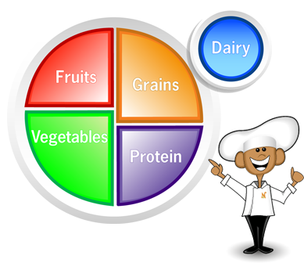
Caring for your body
Everyone has heard this before, and everyone continues to ignore it but "you are what you eat." Everything you put into your body affects you.
As teenagers, we all compare ourselves to the people around us. We become so stuck on our physical appearances and not how we feel.
Don’t base the way you feel about yourself on celebs or people on social media.
Our bodies are affected by EVERYTHING we put in our body whether it is drugs, alcohol or even just food. You have control over the substances you put in your body, good or bad.
Exercising is also a good way to relieve stress.
This Photo by Unknown author is licensed under CC BY-NC-ND.
This Photo by Unknown author is licensed under CC BY-NC-ND.

Slide 4
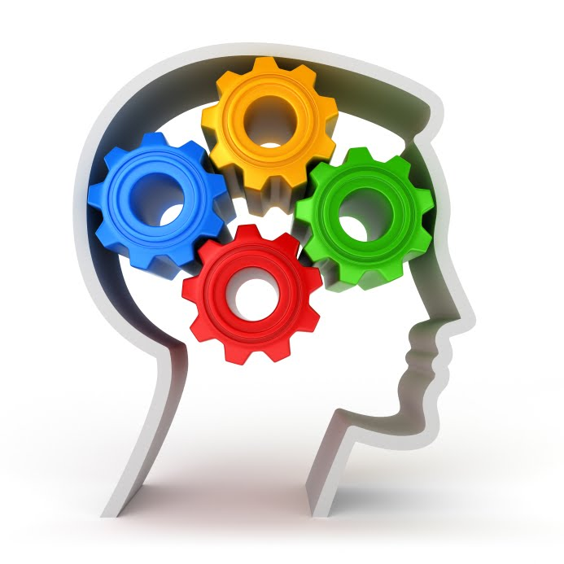
Caring for your brain
The key to caring for your brain is to do things to expand your mind .
There are many ways to do this:
You can journal, write and read to keep your mind sharp.
Do things that makes you feel productive and happy.
Don’t base your intelligence or happiness off your grades. Education is important but shouldn’t be what determines you.
There are also mental barriers that need to be overcome to expand your brain. These include screen time, "the Nerd Syndrome," and pressure.
This Photo by Unknown author is licensed under CC BY.

Slide 5
Caring for your heart
Relationship bank account
Keep promises.
Do small acts of kindness.
Be loyal.
Laughter is the best medicine
Laughter promotes happiness

Slide 6
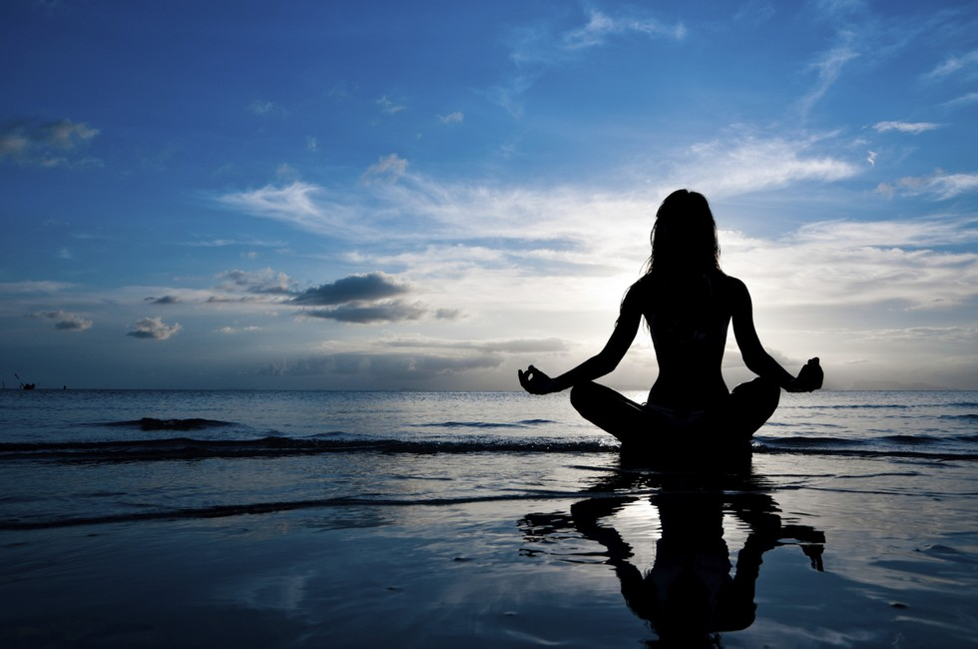
Caring for your soul
How to feed your soul:
Meditating
Taking walks
Reserve some alone time.
Do things that makes you happy.
Sleep is very important because it makes you feel better.
This Photo by Unknown author is licensed under CC BY.

Slide 7
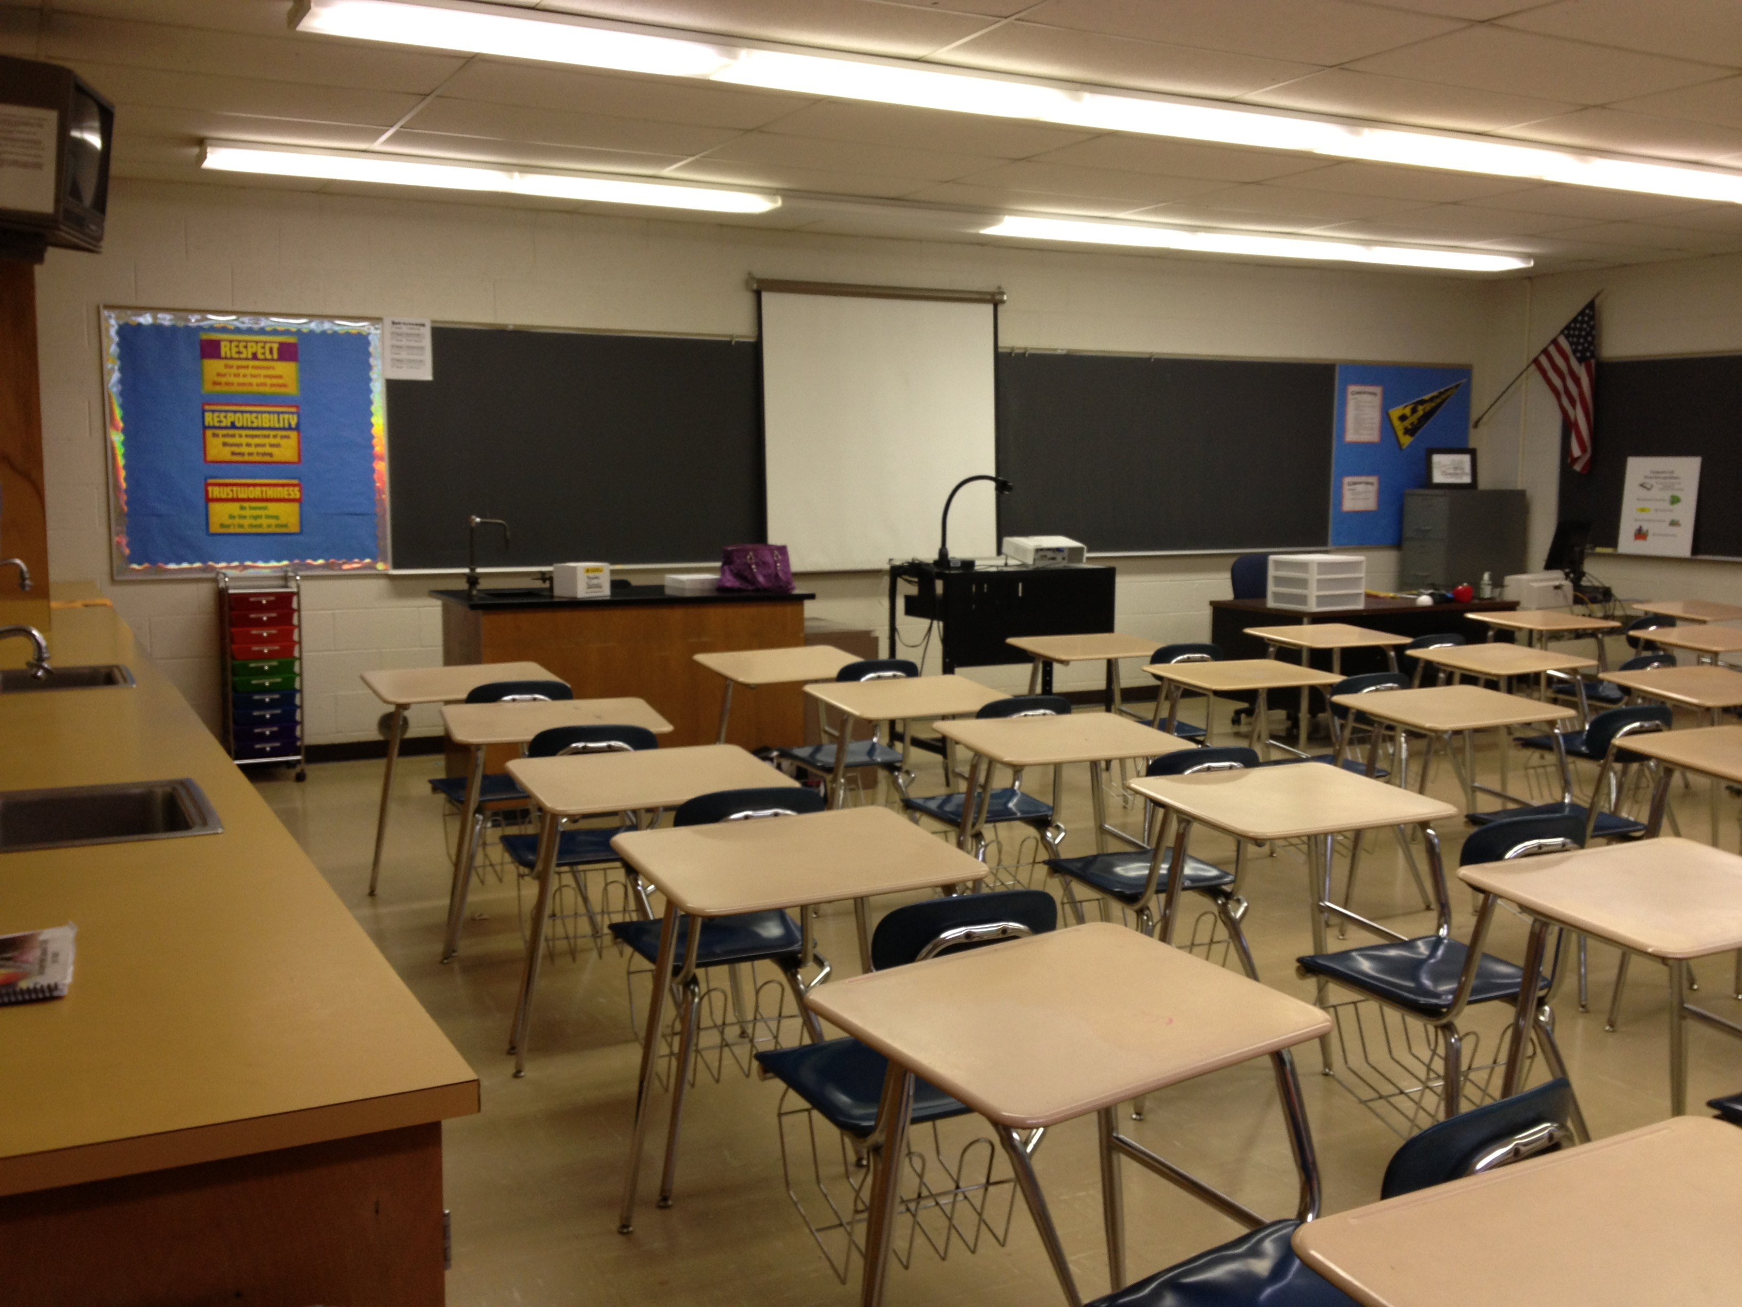
How to apply these in the classroom
Body
Morning exercise with the class
Mind
15 minutes of reading everyday
Heart
Have monthly meetings with the students to check up on them and to see how they are doing
Soul
Meditations every Friday
This Photo by Unknown author is licensed under CC BY-SA.

