Slide 1
Habit 6 – SYNERGIZE
The essence of synergy is to value and respect differences, to build on strengths and to compensate for weaknesses.
Covey says that many of us haven’t actually experienced synergy in our family lives or in other interactions. We’ve been shaped into defensive and protective communications or into believing that life or other people can’t be trusted. Therefore, we have a tendency to not open up to this highly effective principle which “requires enormous personal security and openness and a spirit of adventure”.

Slide 2
Synergy and Communication
Below are 3 different levels of communication and the level of trust that is associated to each:
Defensive communication is of the lowest level and comes out of low-trust situations. It’s characterised by defensiveness, protectiveness and legalistic language which prepares for the eventuality that things may go wrong, that people may become resentful. Such communication isn’t effective and produces only Win/Lose or Lose/Lose outcomes.
Respectful communication is characterised by honesty, authenticity and respect which produces a low form of Win/Win, a compromise where 1+1 = 1½.
Synergistic communication means that 1+1 may equal 8, 16 or even 1’600. The situation produced is better than any originally proposed.

Slide 3
What does it mean?
Table groups-
Give one personal example of each type of communication:
Defensive
Respectful
Synergistic
What were the “outcomes” in each situation?
What are the implications for collaborative learning?

Slide 4
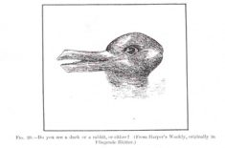
What do you see?

Slide 5
What do you see?
Duck or rabbit?
We see the same black and white lines but we interpret them differently because we’ve been conditioned to interpret them differently.
Covey says: “unless we value the differences in our perceptions, unless we value each other and give credence to the possibility that we’re both right, that life is not always a dichotomous either/or, that there are almost always third alternatives, we will never be able to transcend the limits of that conditioning”. When we see only two alternatives – ours and the “wrong” one – we can look for a synergistic third alternative.

Slide 6
What does it mean?
Make a list of people who irritate you. Do they represent different views that could lead to synergy if you had greater intrinsic security and valued the difference?
The next time you have a disagreement or confrontation with someone, attempt to understand the concerns underlying that person’s position. Address those concerns in a creative and mutually beneficial way.

Slide 7
Habit 6 – SYNERGIZE
https://www.youtube.com/watch?v=GAnJeey-6_Y

Slide 8
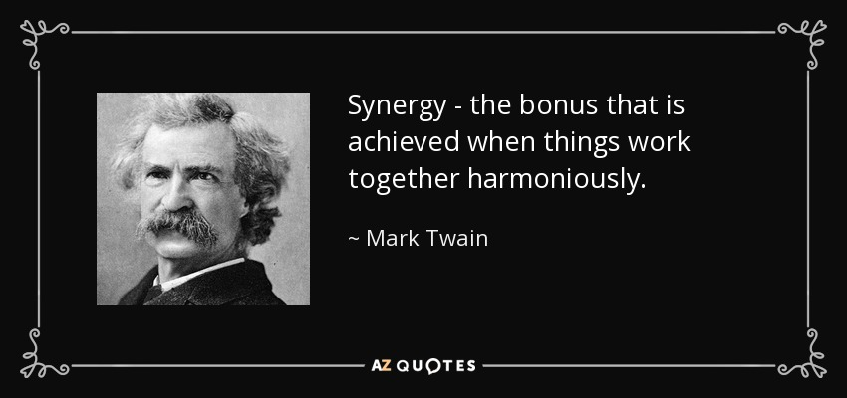
Habit 6 – Final Thoughts

Slide 9
Habit 6 – Final thoughts…
Synergy is everywhere in nature. If you plant two plants close together, the roots commingle and improve the quality of the soil so that both plants will grow better than if they were separated. If you put two pieces of wood together, they will hold much more than the total weight held by each separately. The whole is greater than the sum of its parts. One plus one equals three or more.
Stephen Covey
Teamwork appears most effective if each individual helps others to succeed, increasing the synergy of that team; ideally, every person will contribute different skills to increase the efficiency of the team and develop its unity.
Andrew Carnegie

Slide 10
Habit 6 – Final thoughts…
Coming together is a beginning; keeping together is progress; working together is success.
Henry Ford
Talent wins games, but teamwork and intelligence wins championships.
Michael Jordan

Slide 11
Habit 6 – Final thoughts…
But most importantly…
The life's work of Walt Disney and Ray Kroc had come full-circle, uniting in perfect synergy. McDonald's began to sell its hamburgers and french fries at Disney's theme parks. The ethos of McDonaldland and of Disneyland, never far apart, have finally become one.
Now you can buy a Happy Meal at the Happiest Place on Earth.
Eric Schlosser

