Slide 1
Teaching Fellows Junior, sophomore, Freshman Seminar
Tuesday, October 22

Slide 2
Spread out with your groups in these areas of Plowden. Use the entire auditorium!
13 14 15 16
9 10 11 12
5 6 7 8
1 2 3 4

Slide 3
Relationship bank account
Definition: ○ Your PBA “represents the amount of trust and confidence you have in yourself. Similarly, the RBA represents the amount of trust and confidence you have in each of your relationships.”  Sean Covey, Seven Habits of Highly Effective Teens, Page 132  However, unlike a Personal Bank Account: ○ You have an RBA with every single person you meet. ○ Once you have an RBA with someone, you can never close it. ○ In RBA’s, deposits evaporate and withdrawals turn into stone.  So how do you create a positive RBA balance? ○ Simple. Deposit more than you withdraw (continuously).

Slide 4
RBA Deposits
RBA withdrawals
Keep promises Be considerate Be loyal Listen Say “I’m sorry” Set clear expectations
Break promises Be selfish Be disloyal Don’t listen Say “It’s your fault” Set false expectations

Slide 5
Habit 6: synergize
Work together to achieve more. Definition: ○ Synergy means that the sum is greater that its individual parts.  Start with understanding that we are all UNIQUE. ○ What makes you unique?  Synergy is celebrating difference, NOT just tolerating it.  Synergy is working as a team, NOT just an individual.  Synergy is finding new a better ways, NOT settling.

Slide 7
Activity
Think of something that you are struggling with at the present moment. It can be school-based, relationships, emotional, social, or physical struggles.
Write one of the biggest struggles you have on your sheet of paper. Do not put your name on it.
let us know when you are done.

Slide 8
Brené Brown on Empathy
https://www.youtube.com/watch?v=1Evwgu369Jw

Slide 9
Toxic Positivity (Whitney Hawkins Goodman, owner of The Collaborative Counseling Center.)
If sympathy is shouting down at someone while they’re stuck in a hole, empathy is getting into the hole with them. If “toxic positivity” is telling someone to just “look at the bright side,” support is putting yourself in someone’s shoes, and accepting their feelings for what they are.

Slide 10
The hard-to-face truth is, supporting people isn’t about being “positive.” In fact, when you force positivity down someone’s throat, it can actually have the opposite effect. “Toxic positivity” can make people feel unsafe expressing their negativity, and negativity thrives in isolation. It can make people think there’s something wrong with them for not simply “choosing” happiness, and shame is negativity’s enabling best friend.

Slide 11
When we’re supporting someone who’s hurting, we need to leave room for positivity to grow. And you don’t yell at a flower to “just” grow — you water it. In this case, you water it with listening, with validation, and with unconditional support. It’s OK to experience negative emotions, and with support, we can help people who are stuck in negativity find their own way out. Simply telling them to “be positive” doesn’t cut it.

Slide 13
Validation and hope
Toxic Positivity

Slide 14
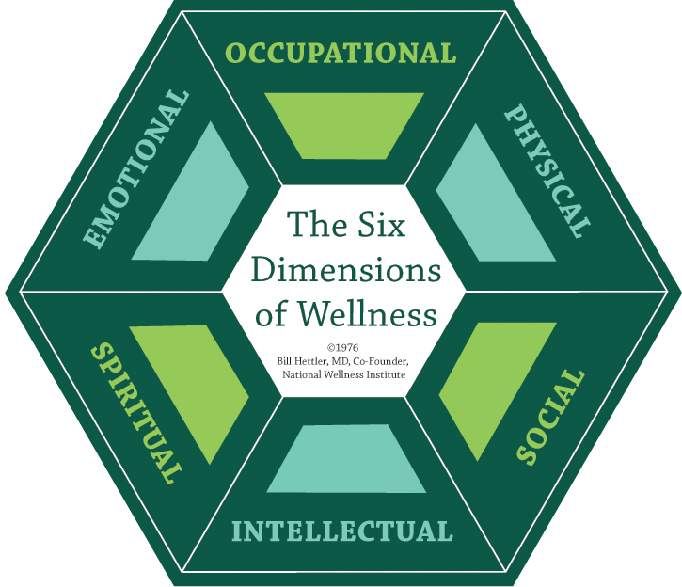
So What?
The National Wellness Institute proposes a holistic wellness model:
Six Dimensions of Wellness

