Slide 1
Seven Habits for Highly Effective People- Habit 1 – Be Proactive!
Dr. Michael Fleming
Program Facilitator, Teaching Fellows, CERRA

Slide 2
Around the World…
If you had unlimited time and resources for a dream vacation, where would you go?
Line up A to Z by first letter of your dream vacation spot.
Turn to the person beside you and discuss the meaning of the following quote from the book:
We first make our habits, then our habits make us. (English Poet)
Notes:
This exercise is used to randomly pair up partners who might not normally pair up. You could also use line up by the first letter of the high school you attended, favorite food, etc. (just change the title…)
For each subsequent activity, have students pair up with a different partner. Keep students moving throughout the presentation.
Another option is to have them line up in two lines facing each other. For each activity have one line rotate one person to right. Last person in line would move to first person position each time.

Slide 3
What is a Habit?
Habits are things we do repeatedly but on auto-pilot.
What are three good (productive and proactive) habits you have formed?
What is one habit that you need to break/change?
“Sow a thought, and you reap and act:
Sow an act, and you reap a habit;
Sow a habit and you reap a character;
Sow a character, and you reap a destiny.” (Samuel Smith)
Notes:
Have students change partners from previous activity. After a couple of minutes, ask for any “brave” volunteers and share out.

Slide 4
The 7 Habits can help you:
Get control of your life
Improve your relationships
Make smarter decisions
Get along with your parents
Overcome addiction(s)
Define your values and what matters most
Get more done in less time
Increase your self-confidence
Be happy
Find balance between school, work, friends, and everything else

Slide 5
Are you centered?
Paradigm – perceptions about the way things are and all are inaccurate or incomplete. They are the way you see something, your point of view, frame of reference or belief. Are your paradigms of self hindering or helping?
Are you:
Friend centered?
Stuff centered?
Boyfriend/girlfriend centered?
School-centered?
Parent-centered?
Other?
OR..are you the real thing?
Principle-centered?
Notes:
Refer students to their text, pp. 18-24 to remind themselves of what each type of centeredness means.

Slide 6
Principles never fail…
Principles- apply equally to everyone.
HONESTY- HARD WORK- LOVE – RESPECT- GRATITUDE - MODERATION – FAIRNESS- INTEGRITY – LOYALTY - RESPONSIBILITY

Slide 7
Baby Steps…
Turn to the person beside you and say something positive about yourself.
Then say something positive about your partner!
Look in the mirror EVERY morning and say something positive about yourself.
Self assessment- what are the principles you currently live by without fail?
What are some principles you need to work on?
Notes:
Have students change partners once again. This would be a good one to allow them to team up with someone they know well. Or, especially good for mentor-mentee discussions.

Slide 8
Your PBA…
Your Personal Bank Account – how you feel about yourself.
Deposits and withdrawals- the things you think, say and do.
Talk to a different partner(s)- how can you make deposits? What would cause you to make a withdrawal?
How might this apply to building relationships with students, parents, peers?
Think positive culture vs. toxic culture!
Notes:
Make time for sharing on this one since it has a really practical application to the classroom. You may want to discuss how teachers need to be intentional in making deposits into student bank accounts.

Slide 9
PBA Account- Key deposits/withdrawals
PBA DEPOSITS
Keep promises to yourself
Do small acts of kindness
Be gentle with yourself
Be honest
Renew yourself
Tap into your talents
PBA WITHDRAWALS
Break personal promises
Keep to yourself
Beat yourself up
Be dishonest
Wear yourself out
Neglect your talents
What deposits have you made today? This week?

Slide 10
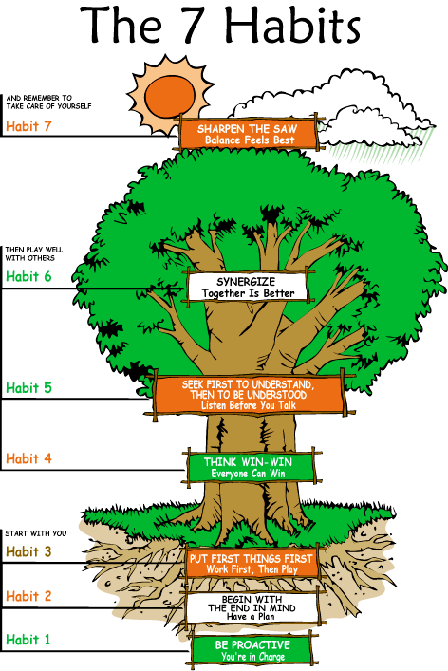
Renewal
Public Victory
Private Victory
Notes:
Remind them of all seven habits pointing out that Covey emphasizes the importance of developing the first habit as all the rest are built upon these basic habits. Explain how the first three habits result in private victories, the next three result in public victories and the last one is all about continuous renewal and care of self.

Slide 11
The Private Victory Habits 1,2,3
Highly effective people understand they must first win the private battles within themselves before they can win the public ones.
Start with the man in the mirror! Self assessment and goal setting are critical steps.
The real tragedy it’s the tragedy of the man who never in his life embraces himself for his one supreme effort- he never stretches to his full capacity, never stands up to his full stature. Arnold Bennet
(side note- Our students deserve our supreme effort!)
Notes:
Refer to text- pp. 30-47

Slide 12
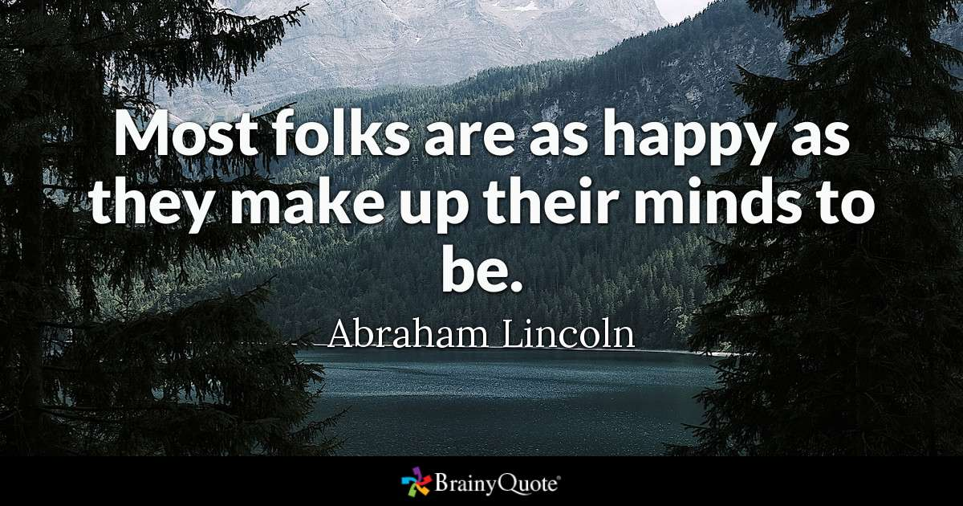

Slide 13
Habit 1 – Be Proactive!
Define the habit.
What does it mean to be proactive?
Habit 1 – Be proactive. Your life doesn't just "happen." Whether you know it or not, it is carefully designed by you. Be proactive is about taking responsibility for your life. You can't keep blaming everything on your parents or grandparents. Proactive people recognize that they are "response-able.“ A proactive person uses proactive language--I can, I will, I prefer, etc. A reactive person uses reactive language--I can't, I have to, if only. Reactive people believe they are not responsible for what they say and do--they have no choice. Work on the things you can control.
Expand your circle of control and reduce your circle of influence!
Notes:
Habit 1 – Be proactive. Your life doesn't just "happen." Whether you know it or not, it is carefully designed by you. Be Proactive is about taking responsibility for your life. You can't keep blaming everything on your parents or grandparents. Proactive people recognize that they are "response-able.“ A proactive person uses proactive language--I can, I will, I prefer, etc. A reactive person uses reactive language--I can't, I have to, if only. Reactive people believe they are not responsible for what they say and do--they have no choice. Work on the things you can control.

Slide 14
Notes:
Emphasize the yellow highlighted box- …even when no one is looking!

Slide 15
Listen to your language!
TALK ABOUT IT…
How can learning to listen for proactive/reactive language
help you in your classroom?
Proactive language
I’ll do it!
I can do better!
Let’s look at all the options!
I choose to…
There’s gotta be a way!
Reactive language
I’ll try
That’s just who I am…
There’s nothing I can do!
I have to…
I can’t

Slide 16
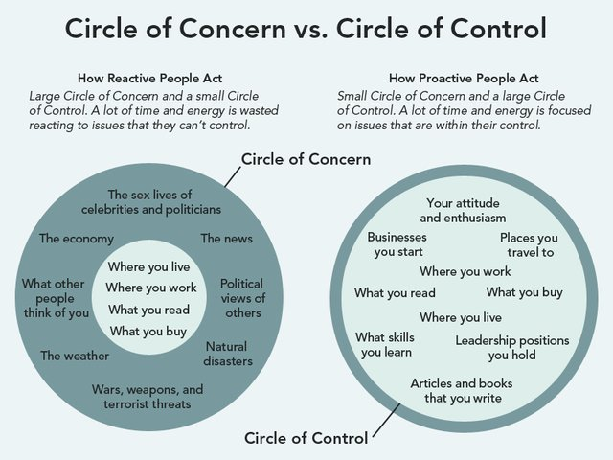
Notes:
Though I did not include it here, a good activity might be to have them draw a Circle map here of their own concerns/control.

Slide 17
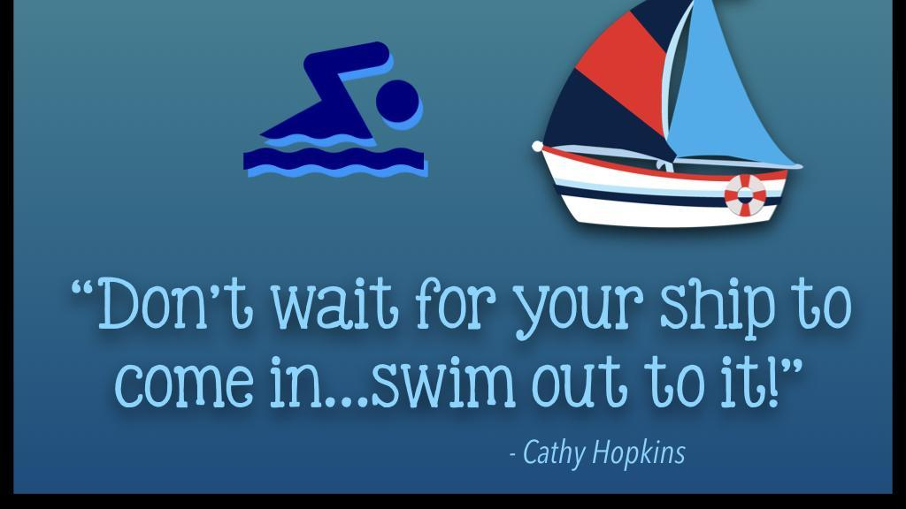
Be a
CAN DO
person!
Notes:
Emphasize the concept of “can do”- see text pp. 62-65.

Slide 18
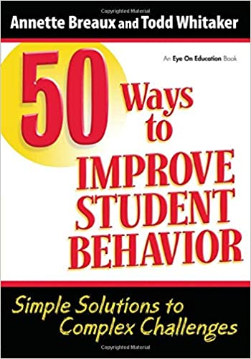
Habit 1 – Be Proactive!
Practical Application…
Just push pause!
Stimulus Space Response
Classroom Management- Why is the “space” important for classroom management? –
Resource: Annette Breaux
Notes:
Discuss with students how there is a stimulus followed by our response with everything that happens to us. Emphasize how important the “pause” is between stimulus and response- that time when we think before we react. Group or partner them to discuss the question.
After they discuss and share, emphasize how 90% of classroom management centers on how we react to students’ actions/behaviors. Annette Breaux is an excellent resource for them. IF they ever get a chance to hear her, they should take advantage of it!

Slide 19
Decision Making Tools
Self Awareness – I can stand apart from myself and observe my thoughts and actions.
Conscience – I can listen to my inner voice to know right from wrong.
Imagination – I can envision new possibilities.
Willpower- I have the power to choose.
Think of a recent difficulty in your life. Using Covey’s “Rosa and Woof” examples as a guide- how might you have reacted proactively to the situation using each tool?
Notes:
See text pp. 65-70.

Slide 20
BABY STEPS
TURN AND TALK…
Identify something in your circle of no control that you are always concerned about. Decide now to drop it.
Give your talking partner one idea to help him/her be more proactive with his/her concern.

Slide 21
Classroom resources: Children’s Lit Habit One Resources
Amazing Grace by Mary Hoffman
The Little Engine That Could by Watty Piper
King Bidgood’s in the Bathtub by Audrey Wood
The Very Lonely Firefly by Eric Carle
The Carrot Seed by Ruth Krauss
Salt in His Shoes by Michael Jordan
Jeremy Thatcher, Dragon Hatcher by Bruce Coville (chapter book)
On My Honor by Marion Bauer (chapter book)
Retrieved from: https://librarylearners.com/leader-library-book-list/
Notes:
This is a list of children’s lit resources that can be used in the classroom.

