Slide 1
Seven Habits for Highly Effective People- Habit 3 – Put First Things First!
Dr. Michael Fleming
Program Facilitator, Teaching Fellows, CERRA

Slide 2
Habit 3 – Put First Things First!
Define the habit – What does it mean to put first things first?
Habit 3: Put First Things First® I spend my time on things that are most important. This means I say no to things I know I should not do. I set priorities, make a schedule, and follow my plan. I am disciplined and organized.
Notes:
Habit 3: Put First Things First® I spend my time on things that are most important. This means I say no to things I know I should not do. I set priorities, make a schedule, and follow my plan. I am disciplined and organized.

Slide 3
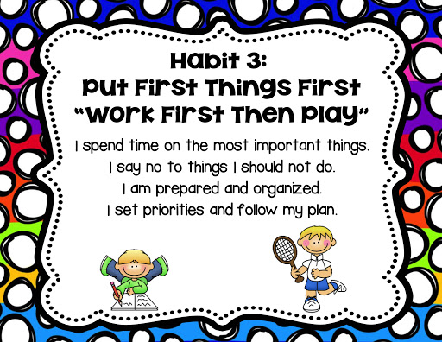
Notes:
Have students do a mental check-off for these. Maybe rate themselves 1-10 with ten being best on how well they put first things first.

Slide 4
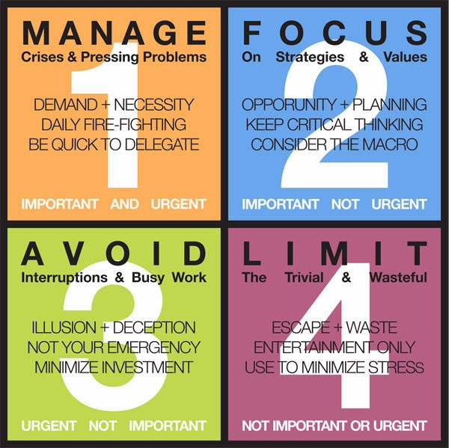
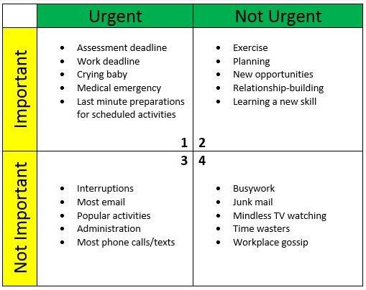
Consider these ideas for spending the right
amount of time in each Quadrant!
Time Quadrants
Procrastinator
Prioritizer
Yes Man
Slacker
Notes:
Explain that this is a model for thinking about how time is or can be spent. Point out the vertical axis of importance and the horizontal axis of urgency; then, click animation to zoom in on the descriptor that defines the time in each quadrant. Click to show the second model and again to explain that these are ideas for spending the right amount of time in each quadrant. Move on to the next slide to show “in a word” what each quadrant represents.

Slide 5
Results of too much time in each quadrant
Stress and anxiety Burnout Mediocre performance | Control of your life Balance High Performance
Reputation for being a pleaser Lack of discipline Feeling like a doormat for others | Lack of responsibility Guilt Flakiness
Shrink -→
← Increase
←Decrease
Eliminate →
Notes:
As in the text, review what each quadrant means by discussing the results of too much time in each quadrant. Discuss Q2 last as it is the only one with positive results.
Once you’ve talked about each quadrant results, you can click to display outer suggestions. Explain that we need to shrink Q1 by procrastinating less, doing things early! Then explain that we should learn to say NO to Q3 time wasters or, at least, limit our time there. Delegate where possible. Cut down Q4- slacker activities- don’t stop, just be proactive in minimizing the time spent there. We need a little Q4 in our lives if we are going to be effective with Habit 7 – sharpening the saw. Finally, increase time spent in Q2 as this is where we are most effective!

Slide 6
Necessity
Opportunity
Interruptions
Trivia
In a word…
Notes:
Have students draw a blank quadrant; then, give them a few minutes to think about the things in their lives over the last week and where those things fit in on the grid.
They should focus on things they did that were necessary; things that were opportunities; interruptions they faced and dealt with; time wasted with trivial activities. After they have their quadrants complete, move on to the next slide.

Slide 7
This Photo by Unknown Author is licensed under CC BY
Notes:
Click on the You Tube link and have students sing along, move about the classroom, dance, etc.

Slide 8
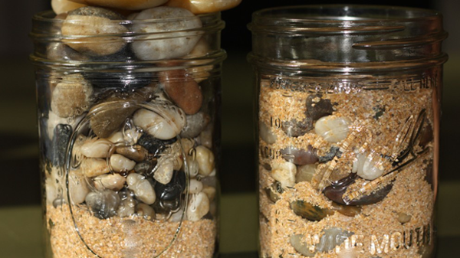
Weekly planning is best…
Three step weekly planning process…
Identify your big rocks.
Block out time for your big rocks.
Schedule everything.
This Photo by Unknown Author is licensed under CC BY
Notes:
Explain that because we tend to think in weekly terms, it’s best to plan a week at a time. Daily planning is too narrow a focus, monthly too broad.
As you talk through each step, use the big rocks analogy by bringing to class a jar, some large rocks, some small pebbles and some sand.
Start by pouring in the sand (the small things in life). Add the pebbles, the next tier of things that are important. And finally, the big rocks. Of course, they won’t fit. Have a second jar and show how you must put the big rocks in first, fill in with pebbles and then pour the sand in so that it falls in and around the rocks and pebbles. An extremely valuable visual to explain the concept AND point out students can do this in their classrooms with their students.

Slide 9
Habit 3 – Put First Things First!
Practical Application
What are some things you do on a daily basis to “put first things first”? What advice do you have for your group?
Discuss
Resource – Time Management – Covey Matrix
https://www.youtube.com/watch?v=ODyG5lKbH08
Notes:
Habit 3: Put First Things First® I spend my time on things that are most important. This means I say no to things I know I should not do. I set priorities, make a schedule, and follow my plan. I am disciplined and organized.

Slide 10
Comfort Zone and Courage Zone
Comfort Zone
Things you’re familiar with, places you know, friends you’re at ease with, activities you enjoy.
Courage Zone
Making new friends, speaking before a large crowd, sticking up for your values.
https://slideplayer.com/slide/8801679/
Notes:
Start with the Wayne Gretzky quote- “you miss 100 percent of the shots you never take”. (Gretzky was one of the greatest hockey players ever.) Have students turn and talk about a time they were forced to step out of the comfort zone into the courage zone. How did it feel when the task or situation was done? Accomplished? Proud?

Slide 11
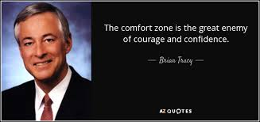
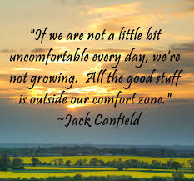
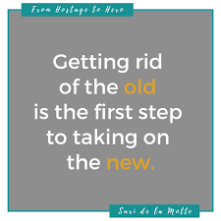
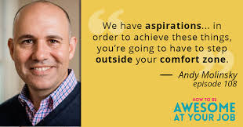
Notes:
Use these quotes to tie up the idea of comfort vs. courage. Pictures will appear with each click of mouse. Have students stand and read loud and proud!
After the last slide, have the entire group read loud and proud together!

Slide 12
Just do it, do it, do it…
Winning means rising each time you fall.
Be strong in the hard moments!
Overcome peer pressure!
Embrace the common denominator of success!
This Photo by Unknown Author is licensed under CC BY-NC
Notes:
Remind them that the Nike slogan- Just do it - applies to more than sports. Click first quote - Remind them of the failures of Abraham Lincoln, text, pp. 121-122.
Click second quote. Have a student read the Frost quote on p. 121. Explain to them that there will be many large and small “hard” moments in their classrooms, faculty meetings, etc. Conflict is inevitable as a part of being human and interacting daily with them. Emphasize that this connects to Habit 1 in that we are to be proactive, professional, practitioners!
Click the third quote. Have them think-pair-share some ways they’ve overcome peer pressure in the past. Emphasize it’s important to care more about what you think of you than what your peers think of you. Discuss some positive examples of peer pressure. Connect to students’ PBAs from the intro session. Click the final quote. Have a student read the Albert Gray quote on p. 125. Discuss what it means to “suck it up” and rely on willpower to do the things that might not be easy or pleasant. Relate how this will be a skill they will need in the school setting.

Slide 13
Baby Steps…
If you’re not already…Set a goal to use a planner for one month. Stick to your plan. Evaluate its usefulness and continue developing the habit. Highlight your “big rocks” and shrink that procrastination box!
Identify your biggest time wasters (Q4) and make a plan for reducing the amount of time spent on them.
Find a quote that speaks to you on resisting peer pressure and keep it visible as you did with your mission to remind you to use courage to resist!

Slide 14
Classroom resources: Children’s Lit Habit 3 – Put First Things First!
Froggy Gets Dressed by Jonathan London
The Little Red Hen by Paul Galdone
The Very Hungry Caterpillar by Eric Carle
Alejandro’s Gift by Richard E. Albert
Jamaica’s Find by Juanita Havill
Justin and the Best Biscuits in the World by Mildred Pitts Walter
Esperanza Rising by Pam Munoz Ryan (chapter book)
Retrieved from: https://librarylearners.com/leader-library-book-list/
Notes:
Just a reminder- would be great if one of your TFs could read one of these to the cohort for this session.

