Slide 1
The resources for this candidate support has been created and provided by CERRA utilizing materials from the National Board of Professional Teaching Standards. No materials or resources may be used for profit by an individual or an organization. Additionally, all facilitators should adhere to the ethical guidelines for supporting candidates found at http://www.nbpts.org/wp-content/uploads/Ethical-Guidelines-Candidate-Support.pdf.

Slide 2

National Board Cohort
Meeting Six

Slide 3
Housekeeping
Make sure you signed in.
Please sit in certificate similar groups.
Burning questions from the homework?
Notes:
5 minutes: Allow for participants to ask any questions that are on their minds regarding their homework. If possible, encourage answers to emerge from their colleagues in the room rather than from you.

Slide 4
Essential Questions
What do I need to consider as I plan my work for Component 2?
How should the Architecture of Accomplished Teaching impact my work for Component 2?
How can I best describe my accomplished practice?
How do I set my student goals?
What are the prompts for the written commentary and on the Contextual Information Sheet really asking me to do?
How will National Board assess my work in Component 2?
Notes:
2 minutes. Briefly go over the essential questions that will guide the session.

Slide 5
Component 2: Essentials
Student work
High, worthwhile goals
Alignment with needs and goals (AAT)
Knowledge of Students standard
Student responsibility
Differentiation
Fairness, equity, and diversity
Accomplished teaching over a period of time
Notes:
5-10 minutes: Remind candidates that while they are focused on analyzing student work, they need to remember that these are essential aspects of the component that need to be addressed. If time allows, candidates may engage in a conversation about the meaning, according to National Board, of these terms and/or the what National Board says differentiation (ex.) looks like/sounds like in a specific setting.

Slide 6
Component 2: Essentials
Notes:
2 minutes. Use the pie chart to remind candidates that all of these aspects are equally important and related.

Slide 7
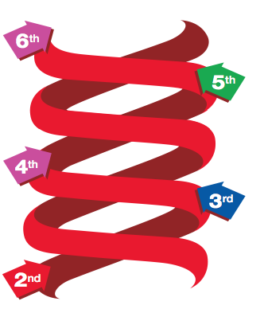
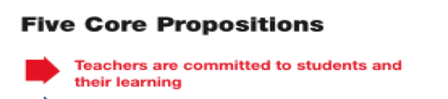
Make Connections to the AAT
Notes:
8 minutes for slides 7-12
The Architecture for Accomplished Teaching (AAT) is a metaphor for what accomplished teachers do in the classroom. What is visible in the classroom may be different but fundamental aspects of teaching are shared by all accomplished teachers.
These slides go through the steps of the Architecture of Accomplished Teaching and relates the steps to the 5 Core Propositions. The questions in the written commentary for Component 2 follow the AAT. Candidates should refer to the prompts for the written commentary in their certificate-specific component instructions as the facilitator is discussing the AAT. Remind the candidates how their certificate specific standards also can help them decide what to include in the written commentary.

Slide 8
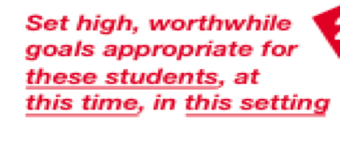
Make Connections to the AAT
Notes:
8 minutes for slides 7-12
The Architecture for Accomplished Teaching (AAT) is a metaphor for what accomplished teachers do in the classroom. What is visible in the classroom may be different but fundamental aspects of teaching are shared by all accomplished teachers.
These slides go through the steps of the Architecture of Accomplished Teaching and relates the steps to the 5 Core Propositions. The questions in the written commentary for Component 2 follow the AAT. Candidates should refer to the prompts for the written commentary in their certificate-specific component instructions as the facilitator is discussing the AAT. Remind the candidates how their certificate specific standards also can help them decide what to include in the written commentary.

Slide 9
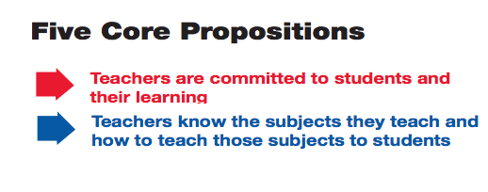
Make Connections to the AAT
Notes:
8 minutes for slides 7-12
The Architecture for Accomplished Teaching (AAT) is a metaphor for what accomplished teachers do in the classroom. What is visible in the classroom may be different but fundamental aspects of teaching are shared by all accomplished teachers.
These slides go through the steps of the Architecture of Accomplished Teaching and relates the steps to the 5 Core Propositions. The questions in the written commentary for Component 2 follow the AAT. Candidates should refer to the prompts for the written commentary in their certificate-specific component instructions as the facilitator is discussing the AAT. Remind the candidates how their certificate specific standards also can help them decide what to include in the written commentary.

Slide 10
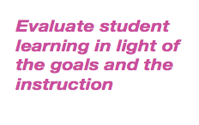
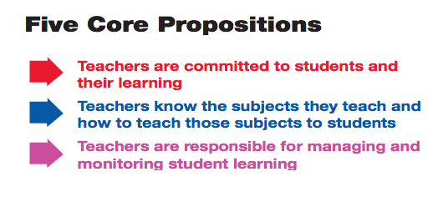
Make Connections to the AAT
Notes:
8 minutes for slides 7-12
The Architecture for Accomplished Teaching (AAT) is a metaphor for what accomplished teachers do in the classroom. What is visible in the classroom may be different but fundamental aspects of teaching are shared by all accomplished teachers.
These slides go through the steps of the Architecture of Accomplished Teaching and relates the steps to the 5 Core Propositions. The questions in the written commentary for Component 2 follow the AAT. Candidates should refer to the prompts for the written commentary in their certificate-specific component instructions as the facilitator is discussing the AAT. Remind the candidates how their certificate specific standards also can help them decide what to include in the written commentary.

Slide 11
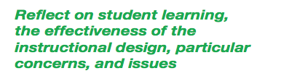
Make Connections to the AAT
Notes:
8 minutes for slides 7-12
The Architecture for Accomplished Teaching (AAT) is a metaphor for what accomplished teachers do in the classroom. What is visible in the classroom may be different but fundamental aspects of teaching are shared by all accomplished teachers.
These slides go through the steps of the Architecture of Accomplished Teaching and relates the steps to the 5 Core Propositions. The questions in the written commentary for Component 2 follow the AAT. Candidates should refer to the prompts for the written commentary in their certificate-specific component instructions as the facilitator is discussing the AAT. Remind the candidates how their certificate specific standards also can help them decide what to include in the written commentary.

Slide 12

Make Connections to the AAT
Notes:
8 minutes for slides 7-12
The Architecture for Accomplished Teaching (AAT) is a metaphor for what accomplished teachers do in the classroom. What is visible in the classroom may be different but fundamental aspects of teaching are shared by all accomplished teachers.
These slides go through the steps of the Architecture of Accomplished Teaching and relates the steps to the 5 Core Propositions. The questions in the written commentary for Component 2 follow the AAT. Candidates should refer to the prompts for the written commentary in their certificate-specific component instructions as the facilitator is discussing the AAT. Remind the candidates how their certificate specific standards also can help them decide what to include in the written commentary.

Slide 13
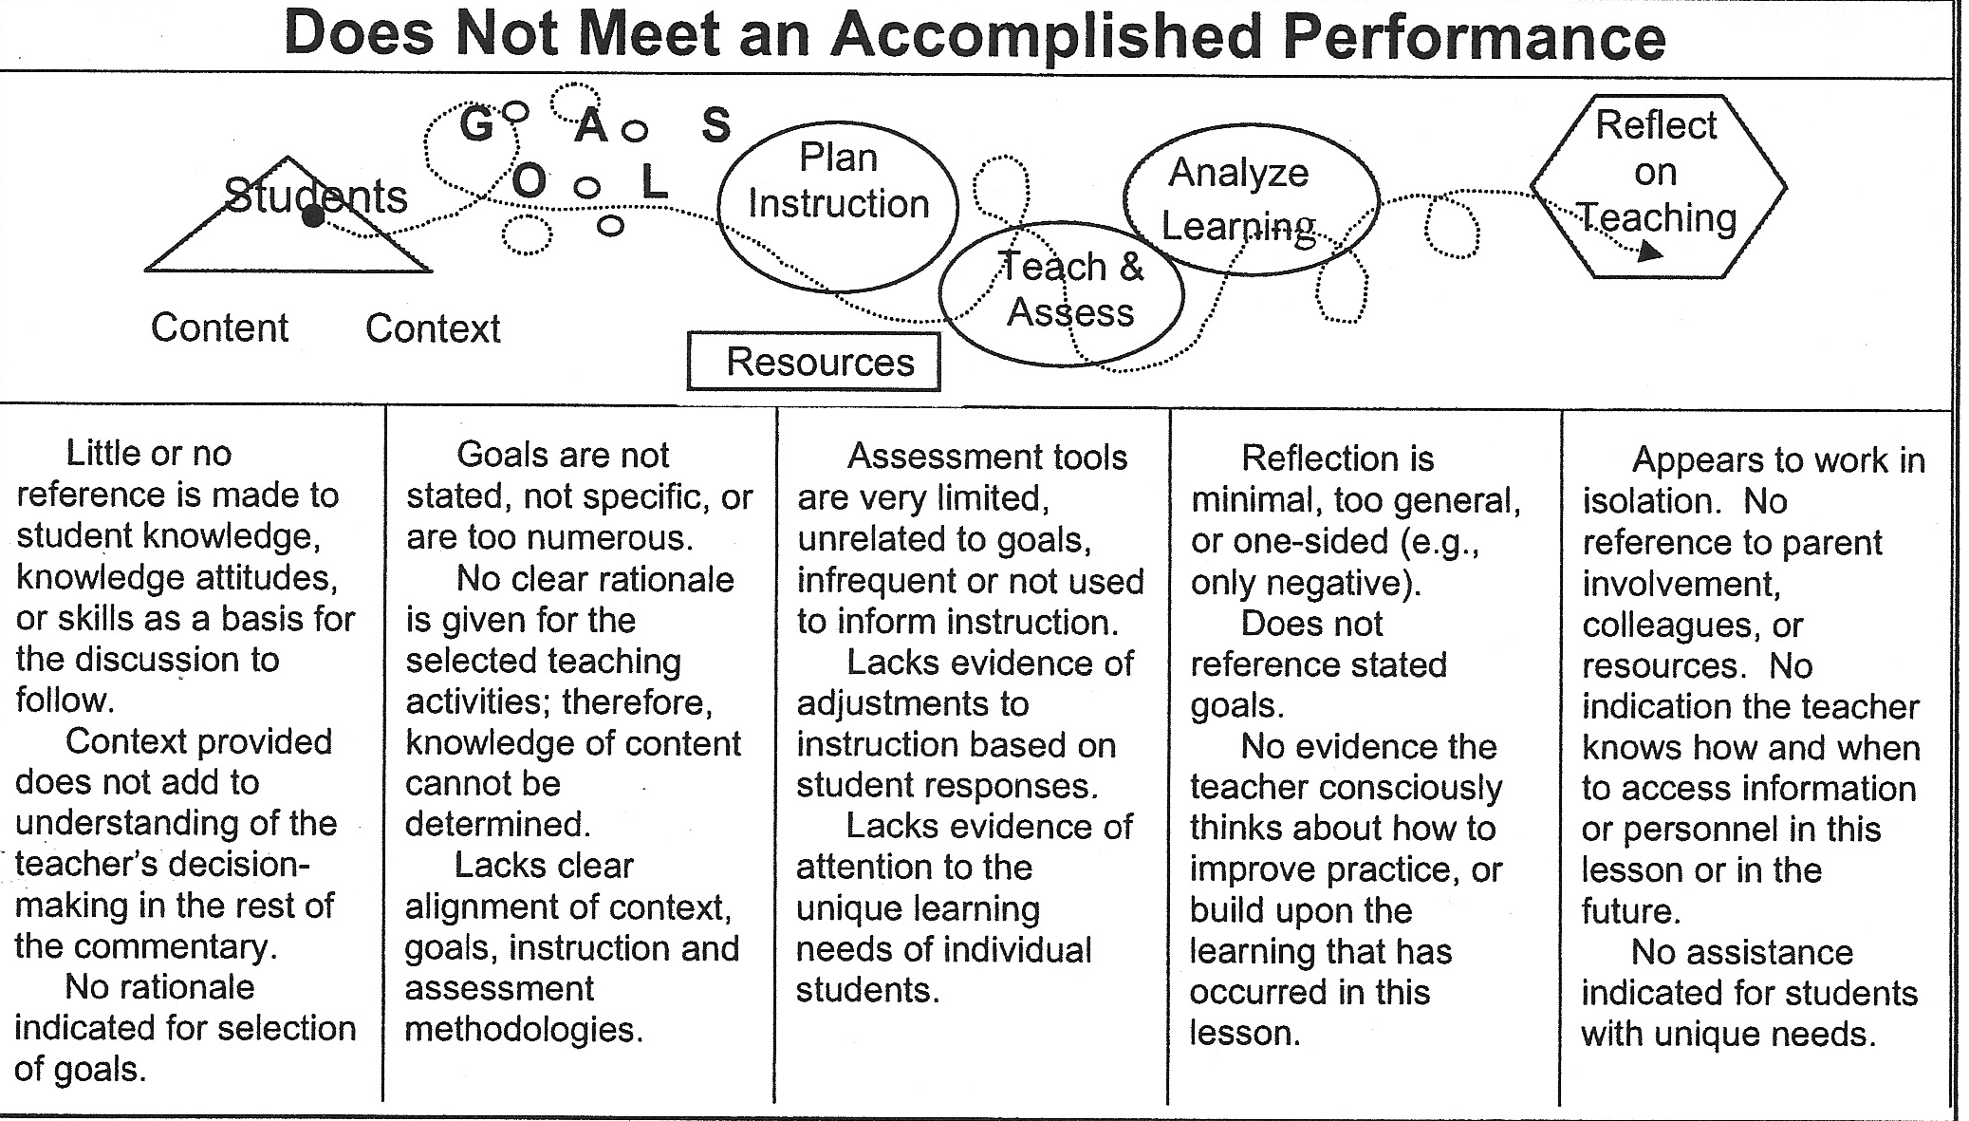
Weak connections between knowing students and selecting the right goals means …
13
From Accomplished Teaching: The Key to National Board Certification by Jennings, Joseph, and Orlando, 2007.
Notes:
5-7 minutes. The candidates have seen this graphic before. Let them look over it and point out key take-aways or examples of what not to do.

Slide 14
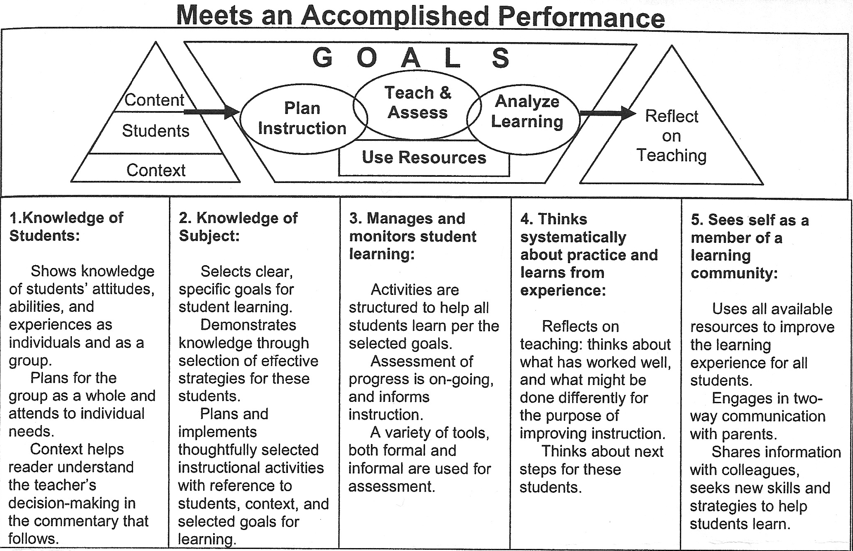
Strong connections between knowing students and selecting the right goals means …
14
From Accomplished Teaching: The Key to National Board Certification by Jennings, Joseph, and Orlando
Notes:
5-7 minutes. The candidates have seen this graphic before. Let them look over it and point out key take-aways about how they will craft their written commentary.

Slide 15
Setting goals
High and worthwhile
Assessable
Appropriate
The goal should state what is important for mastery with consideration of the subject matter and developmental level of the students.
What evidence will demonstrate mastery?
Designed for the students at this time in this setting
Describes what the students will know and what they will be able to do; be specific.
A goal is not an activity.
REMEMBER:
15
Notes:
10 minutes. Use the graphic to describe the process of setting goals.

Slide 16
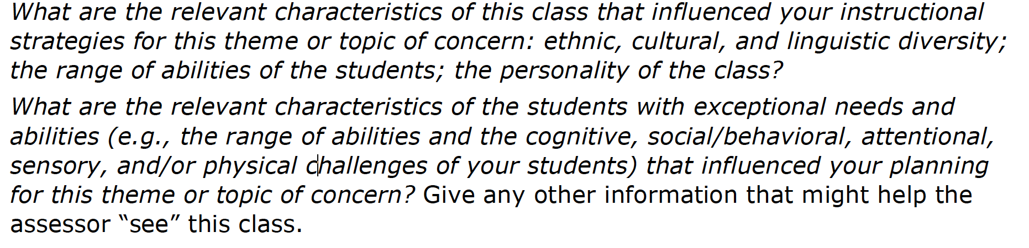
Analyzing the prompts
Look at the prompts below, which were taken from the Middle Childhood Generalist Component 2 Portfolio Instructions. Which types of writing are required? What would you need to include?
Notes:
7-10 minutes: Unpack the prompt and answer the questions in blue as a whole group. Ask the participants to dissect the prompt and explain what needs to be included in the response. Encourage the candidates to think about how their certificate-specific standards can inform their response.

Slide 17
Unpacking the rubric
Review the four different levels of the rubric provided at the end of your certificate-specific Component 2 instructions.
What are the main differences between each level?
Notes:
10 minutes: Have them work with an elbow partner to unpack the rubric and then have key take-aways shared with the whole group.

Slide 18
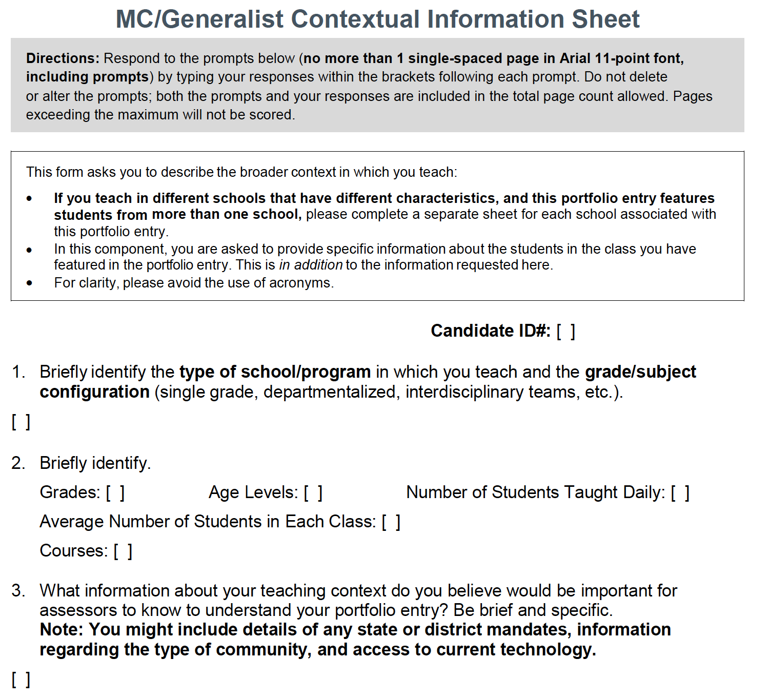
Contextual Information Sheet
What do your instructions ask for on the Contextual Information Sheet?
18
Notes:
10 minutes: Have them work with a like-certificate partner to discuss what needs to be included on their form.

Slide 19
Work Time
*Peer review
*Work on Contextual Information Sheet.
*Begin analyzing student work.
Notes:
They may work on these three things for the remainder of the time.

Slide 20
Homework, Preparation, and Advice
Homework and Preparation:
Before the next meeting, you need to complete the following:
  Complete the first two sections of the written commentary for Component 2.
  IMPORTANT REMINDER: If you have not registered and paid for your components, you must do it before February 28th.
Advice: It is time to push past planning and start doing. This may mean that you teach your identified unit or you start collecting student work or you start writing. Don’t let time get away from you! Expect to make lots of revisions. It is part of the process. JUST DO IT!
Notes:
5 minutes. Close the meeting by reviewing the homework/prep work required for the next meeting.

