Slide 1
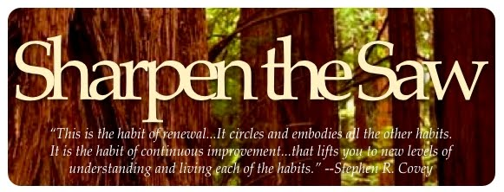
Mindfulness

Slide 3
Group Chat Sharpening the Saw: Mind and Soul (11:00-11:10)
How are you working to improve your mind and soul?
What feeds your soul?
Does the heart matter?
What things do you do that make you most happy?
What inspires you and gives you peace?
What are songs, books, movies, etc., that make you want to be/do better?
Can you think of someone really good at making people happy?
What are their characteristics?

Slide 4
Mindful Observation: Mindfulness Walk (11:15-11:30)
Walk through and/or around Withers for 10 minutes. Look around and pay attention to the environment. Focus on something you haven’t really paid attention to before. Choose something and focus on watching it for a minute or two. This could be a flower or an insect, the clouds, a crack in the wall, etc.
Don’t do anything except notice the thing you are looking at. Simply relax into watching for as long as your concentration allows.
Look at this object as if you are seeing it for the first time.
Visually explore every aspect of its formation, and allow yourself to be consumed by its presence.

Slide 5
Mindfulness Walk Debrief (11:30-11:40)
This exercise is simple but incredibly powerful because it helps you notice and appreciate seemingly simple elements of your environment in a more profound way.
The exercise is designed to connect us with the beauty of the natural environment, something that is easily missed when we are rushing around in the car or hopping on and off trains on the way to work.

Slide 6
M&Ms and Mindfulness (11:40-11:50)

Slide 7
Baby Steps to Sharpen the Saw (11:50-12)
Page 242 (4-11)
Mindful Appreciation
In this last exercise, all you have to do is notice 5 things in your day that usually go unappreciated.
These things can be objects or people; it’s up to you. Use a notepad to check off 5 by the end of the day.
The point of this exercise is to simply give thanks and appreciate the seemingly insignificant things in life, the things that support our existence but rarely get a second thought amidst our desire for bigger and better things.
Do you know how these things/processes came to exist, or how they really work?
Have you ever properly acknowledged how these things benefit your life and the lives of others?
Have you ever thought about what life might be like without these things?
Have you ever stopped to notice their finer, more intricate details?
Have you ever sat down and thought about the relationships between these things and how together they play an interconnected role in the functioning of the earth?
Once you have identified your 5 things, make it your duty to find out everything you can about their creation and purpose to truly appreciate the way in which they support your life.

