Slide 1

Growing Our Own:
A Pre-Collegiate Webinar Series

Slide 2
CERRA’s
Pre-Collegiate Programs

Slide 3
CERRA’s Mission
To provide collaborative leadership in the recruitment, retention, and advancement of outstanding educators for all children in South Carolina

Slide 4
Continuum of Programs

Slide 5
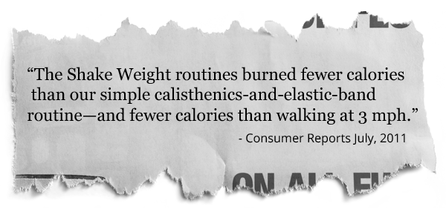
Homegrown Recruitment
HELP WANTED
Applicants must have a college degree, caring personality, pleasant disposition, and strong written, oral and interpersonal communications skills. Those who apply should have strong listening skills, be adept at technology integration, have a high tolerance for frustration (while maintaining a nurturing spirit), and have a history of and willingness to continue professional growth. Most of all, applicants must be willing to change, consistently.

Slide 6
CERRA’s Pre-Collegiate Regions
Region 1
Upstate
Region 3
Midlands
Region 4
Pee Dee
Region 2
Savannah River
The State Public Charter School District and Palmetto Unified School District serve students in schools across the state of South Carolina.
Region 5
Lowcountry

Slide 7
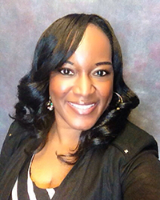
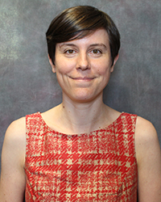
CERRA’s Pre-Collegiate Programs
Marcella Wine-Snyder Director of Pre-Collegiate Programs
Carrie Hamiter
Pre-Collegiate Program’s Specialist

Slide 8
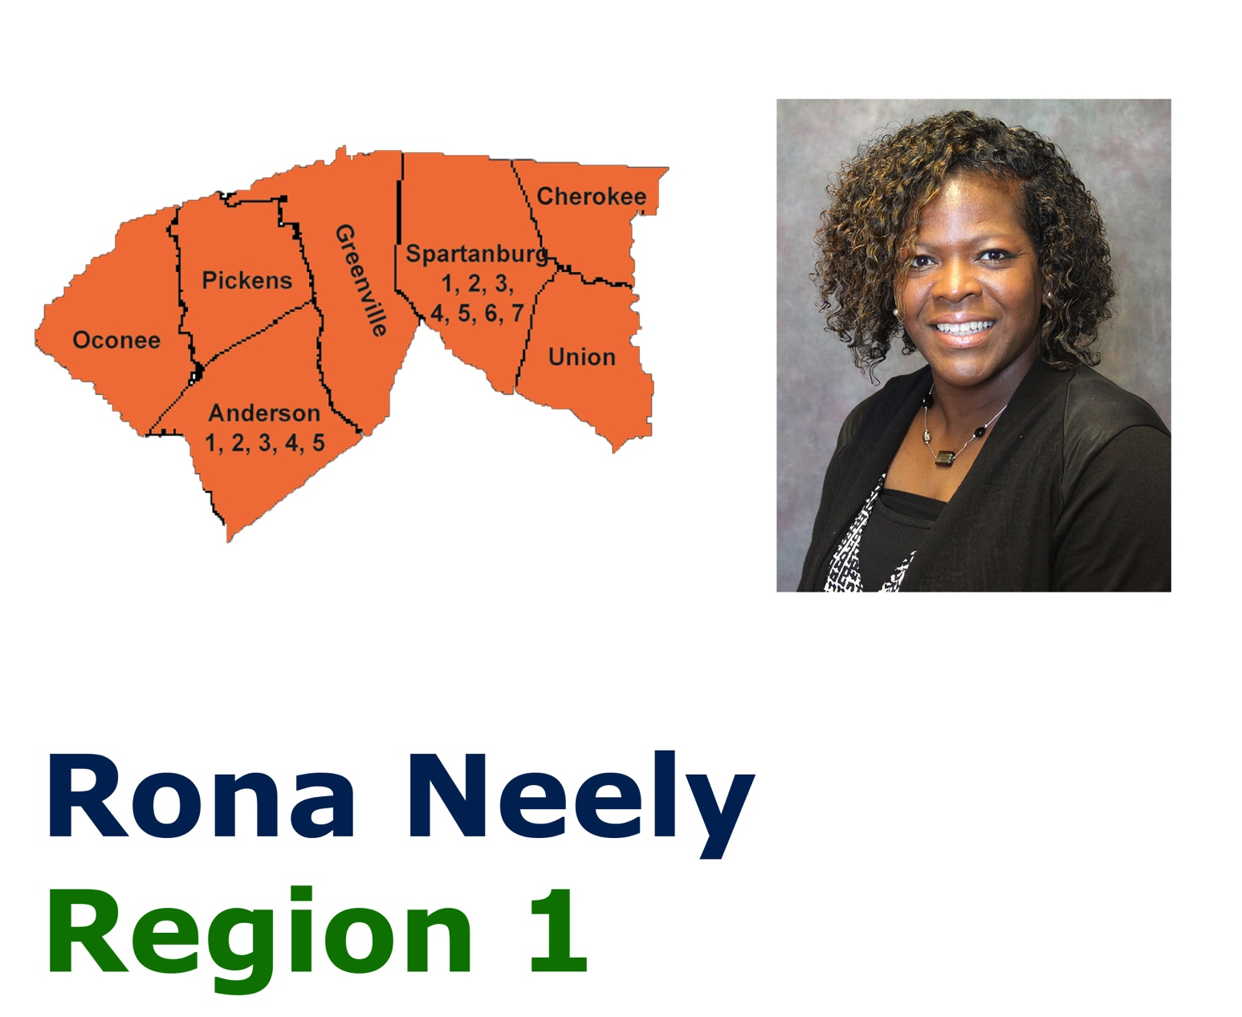
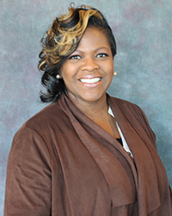
Pre-Collegiate Program Facilitator
Rona Neely
Region One: Upstate

Slide 9
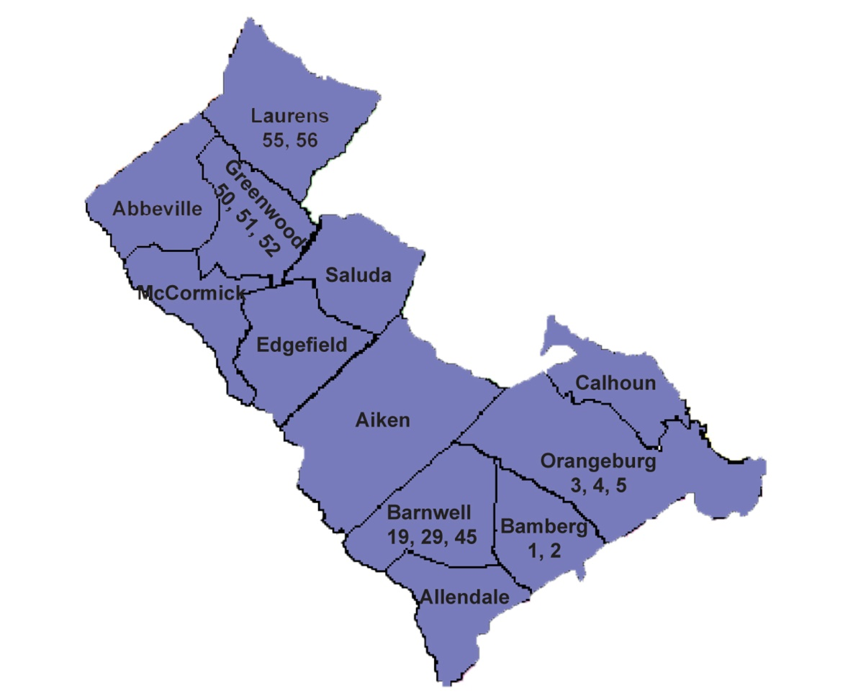
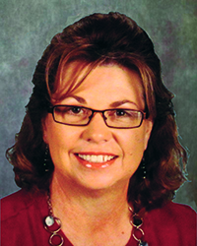
Pre-Collegiate Program Facilitator
Karen Pack
Region Two: Savannah River

Slide 10
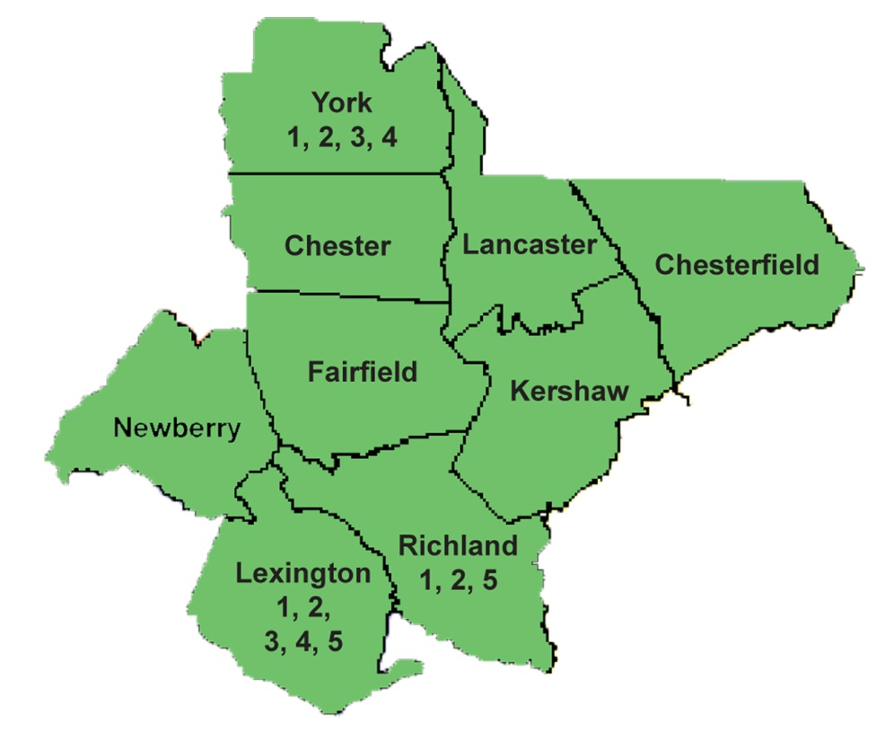
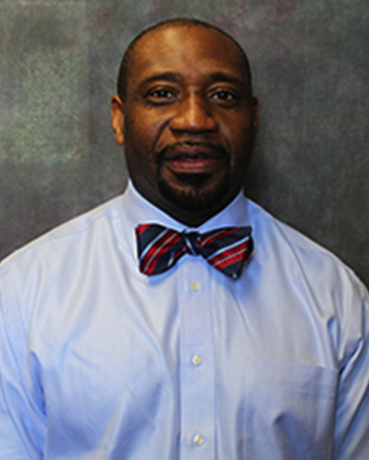
Pre-Collegiate Program Facilitator
Arthur Pinckney
Region Three: Midlands

Slide 11
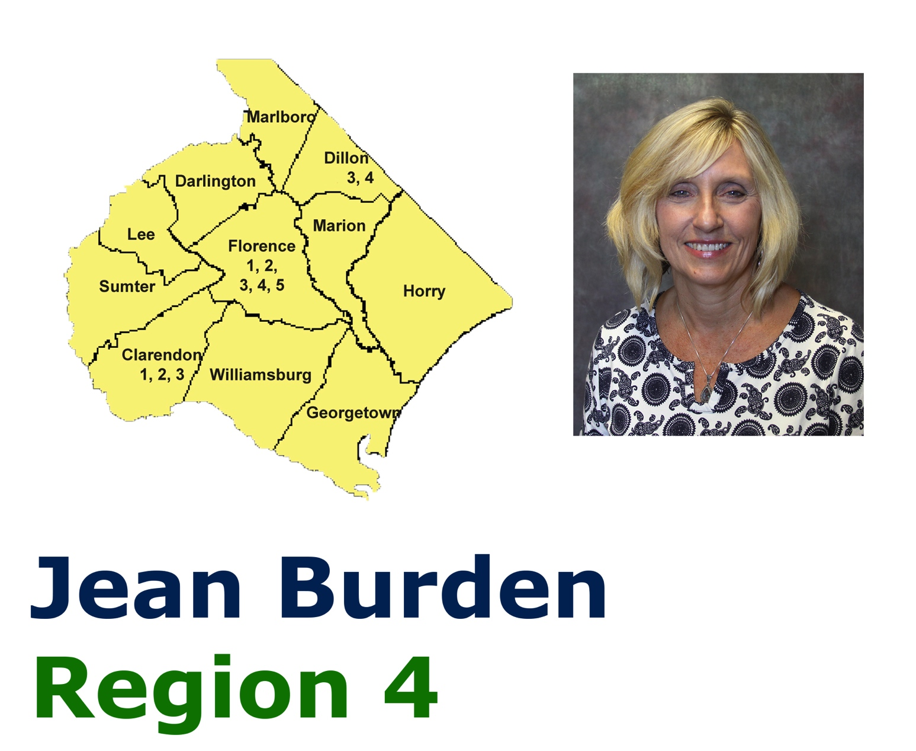
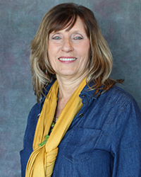
Pre-Collegiate Program Facilitator
Jean Burden
Region Four: Pee Dee

Slide 12
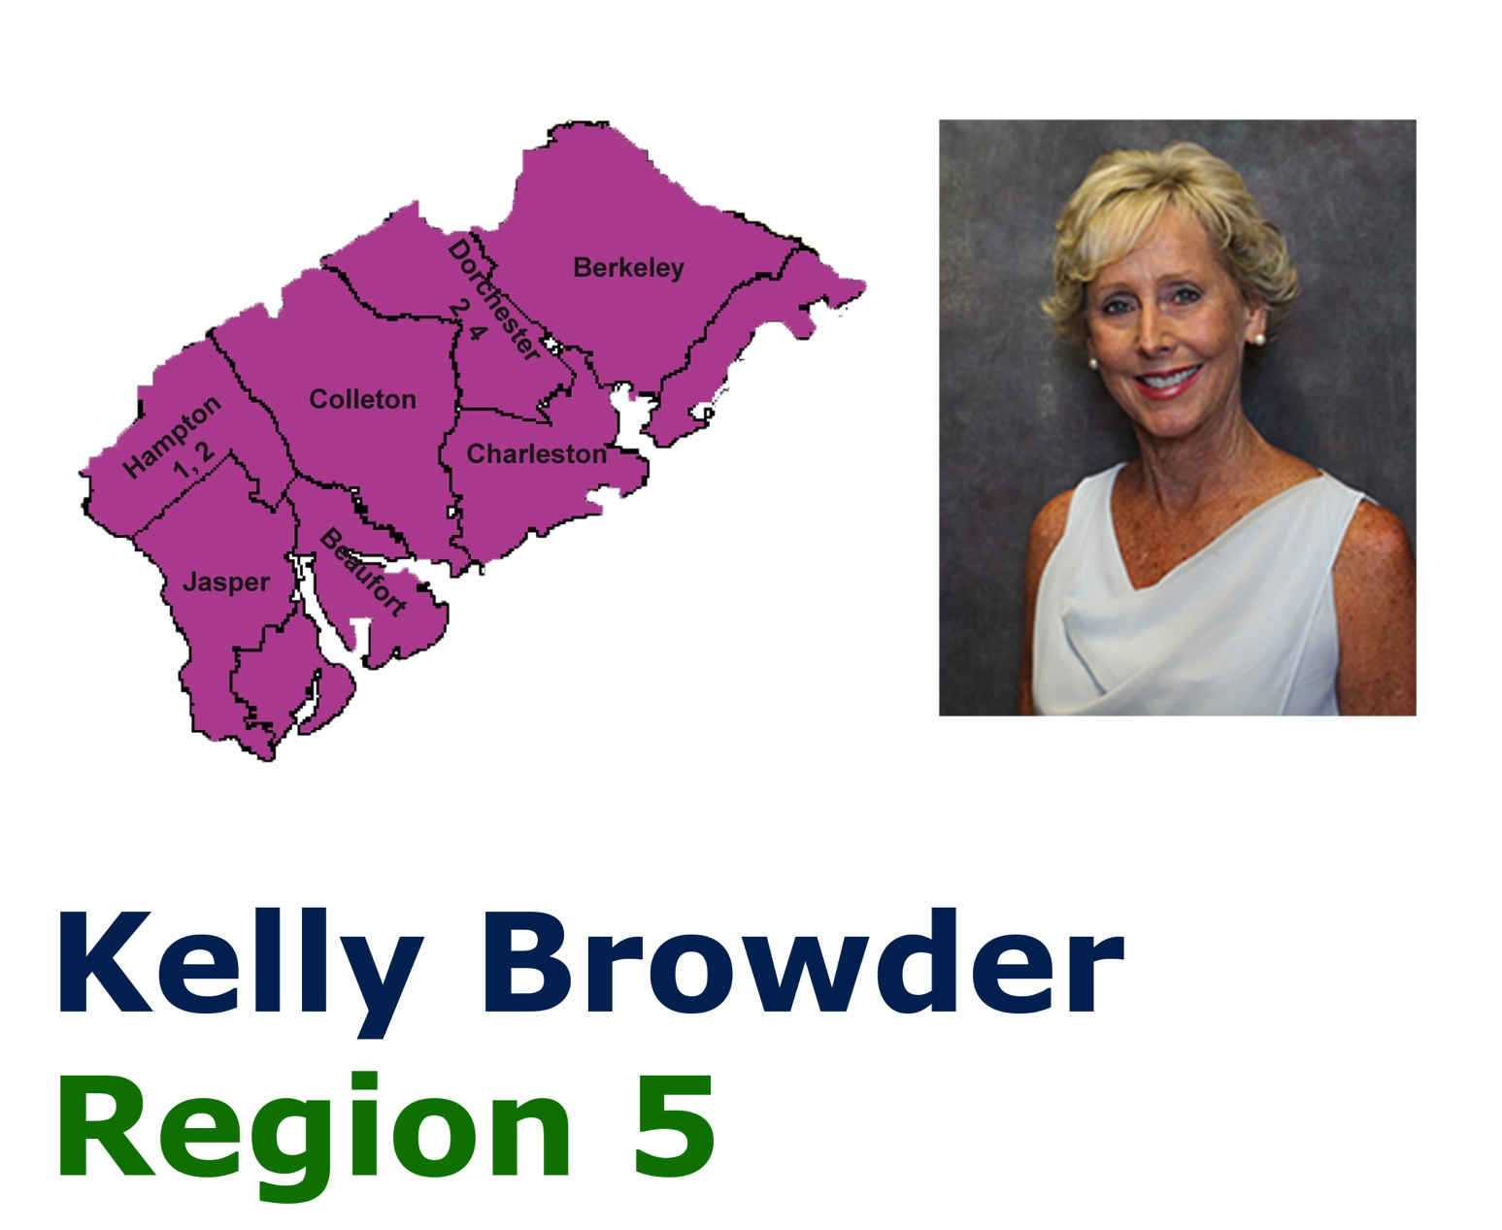
Pre-Collegiate Program Facilitator
Kelly Browder
Region Five: Lowcountry

Slide 13

Role of the Program Facilitator
Ambassador for the teaching profession
Provide support and assistance
Develop relationships with key school and
college/university personnel

Slide 14

CERRA’s
ProTeam Program

Slide 15
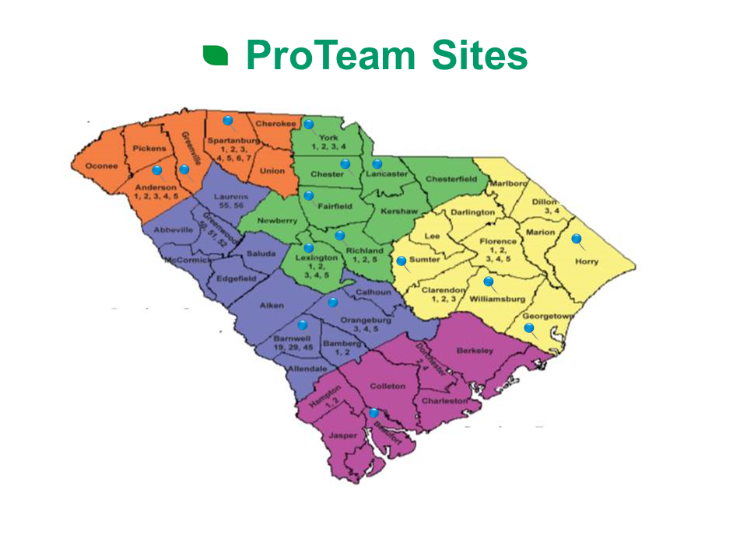
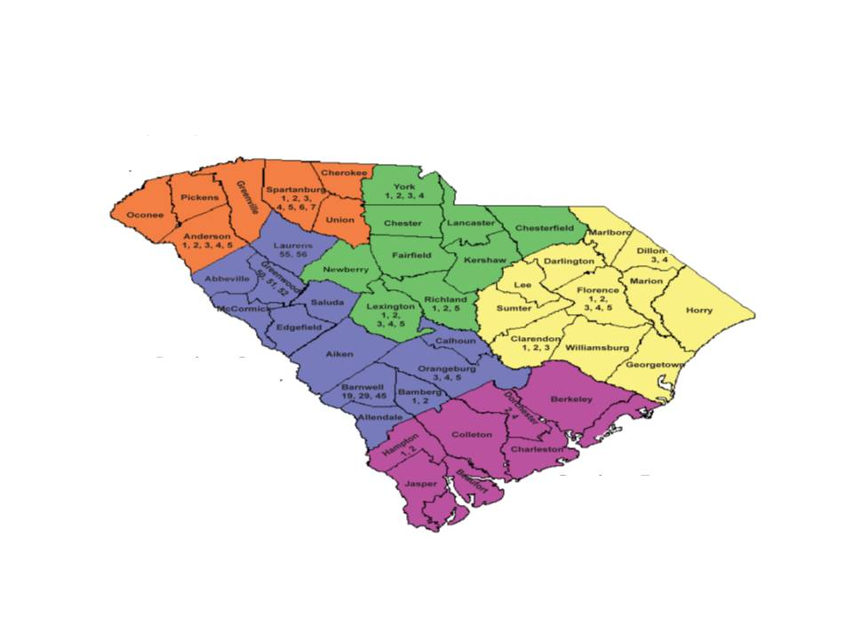
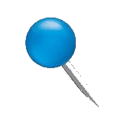
Statewide View

Slide 16

ProTeam Mission
To make students who exhibit the potential for success aware of the skills needed to complete college and consider education as a viable career option
To expand the pool of minority and male teachers available to the public schools of South Carolina

Slide 17
ProTeam Eligibility Criteria
7th and/or 8th graders
Top 40% of current grade level
Positive recommendations from current teachers
Disposition or potential for post-secondary education

Slide 18
ProTeam Curriculum Goals
Develop a strong sense of self
Develop insights into working cooperatively with others
Provide opportunities to experience the art of teaching
Explore what it means to be a teacher
Develop a professional attitude about life with a dream or vision for the future

Slide 19

DreamQuest Curriculum

Slide 20

ProTeam Curriculum
Module One: I Can Self-Reflect
Module Two: I Can Communicate
Module Three: I Can Be Different
Module Four: I Can Think Positively

Slide 21
ProTeam Curriculum
Module Five: I Can Teach Others
Module Six: I Can Make Decisions
Module Seven: I Can Plan for a Successful Future

Slide 22



CENTER FOR EDUCATOR RECRUITMENT, RETENTION, & ADVANCEMENT
www.cerra.org
www.proteamsc.com
www.teachercadets.com
facebook.com/teachercadets
Follow @teachercadets
pinterest.com/cerra1985

Slide 23
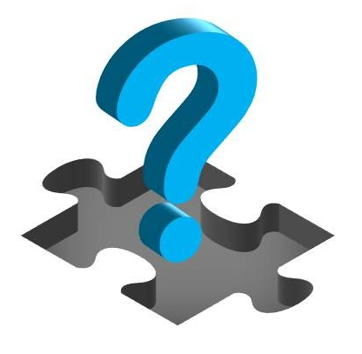
Q&A Session

